Slide 1
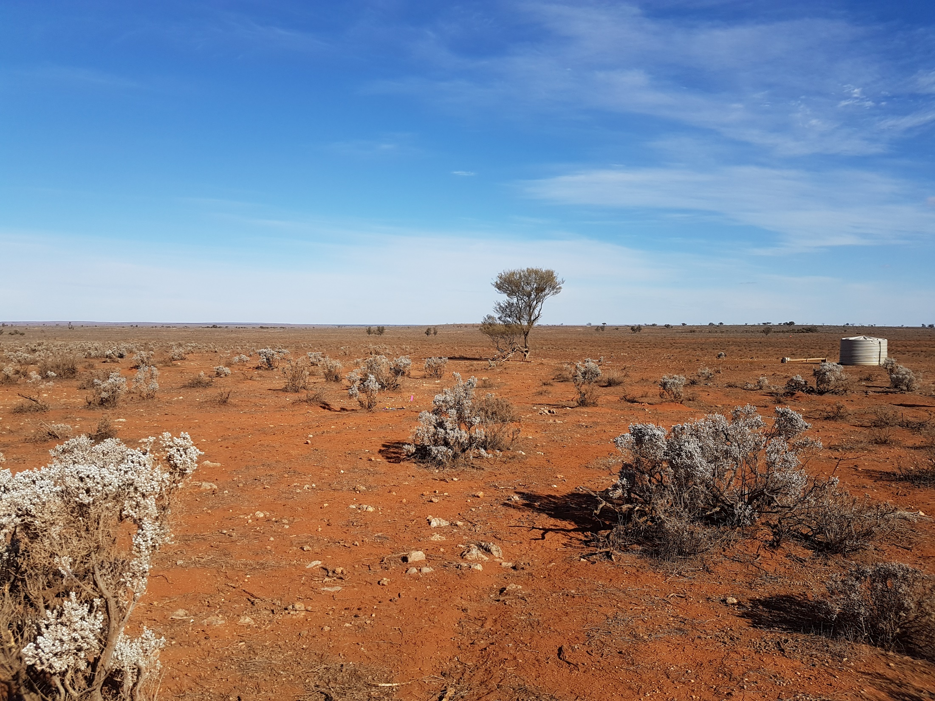

Copper Blow Cu-Au Project
SMEDG
23 January 2020

Slide 2
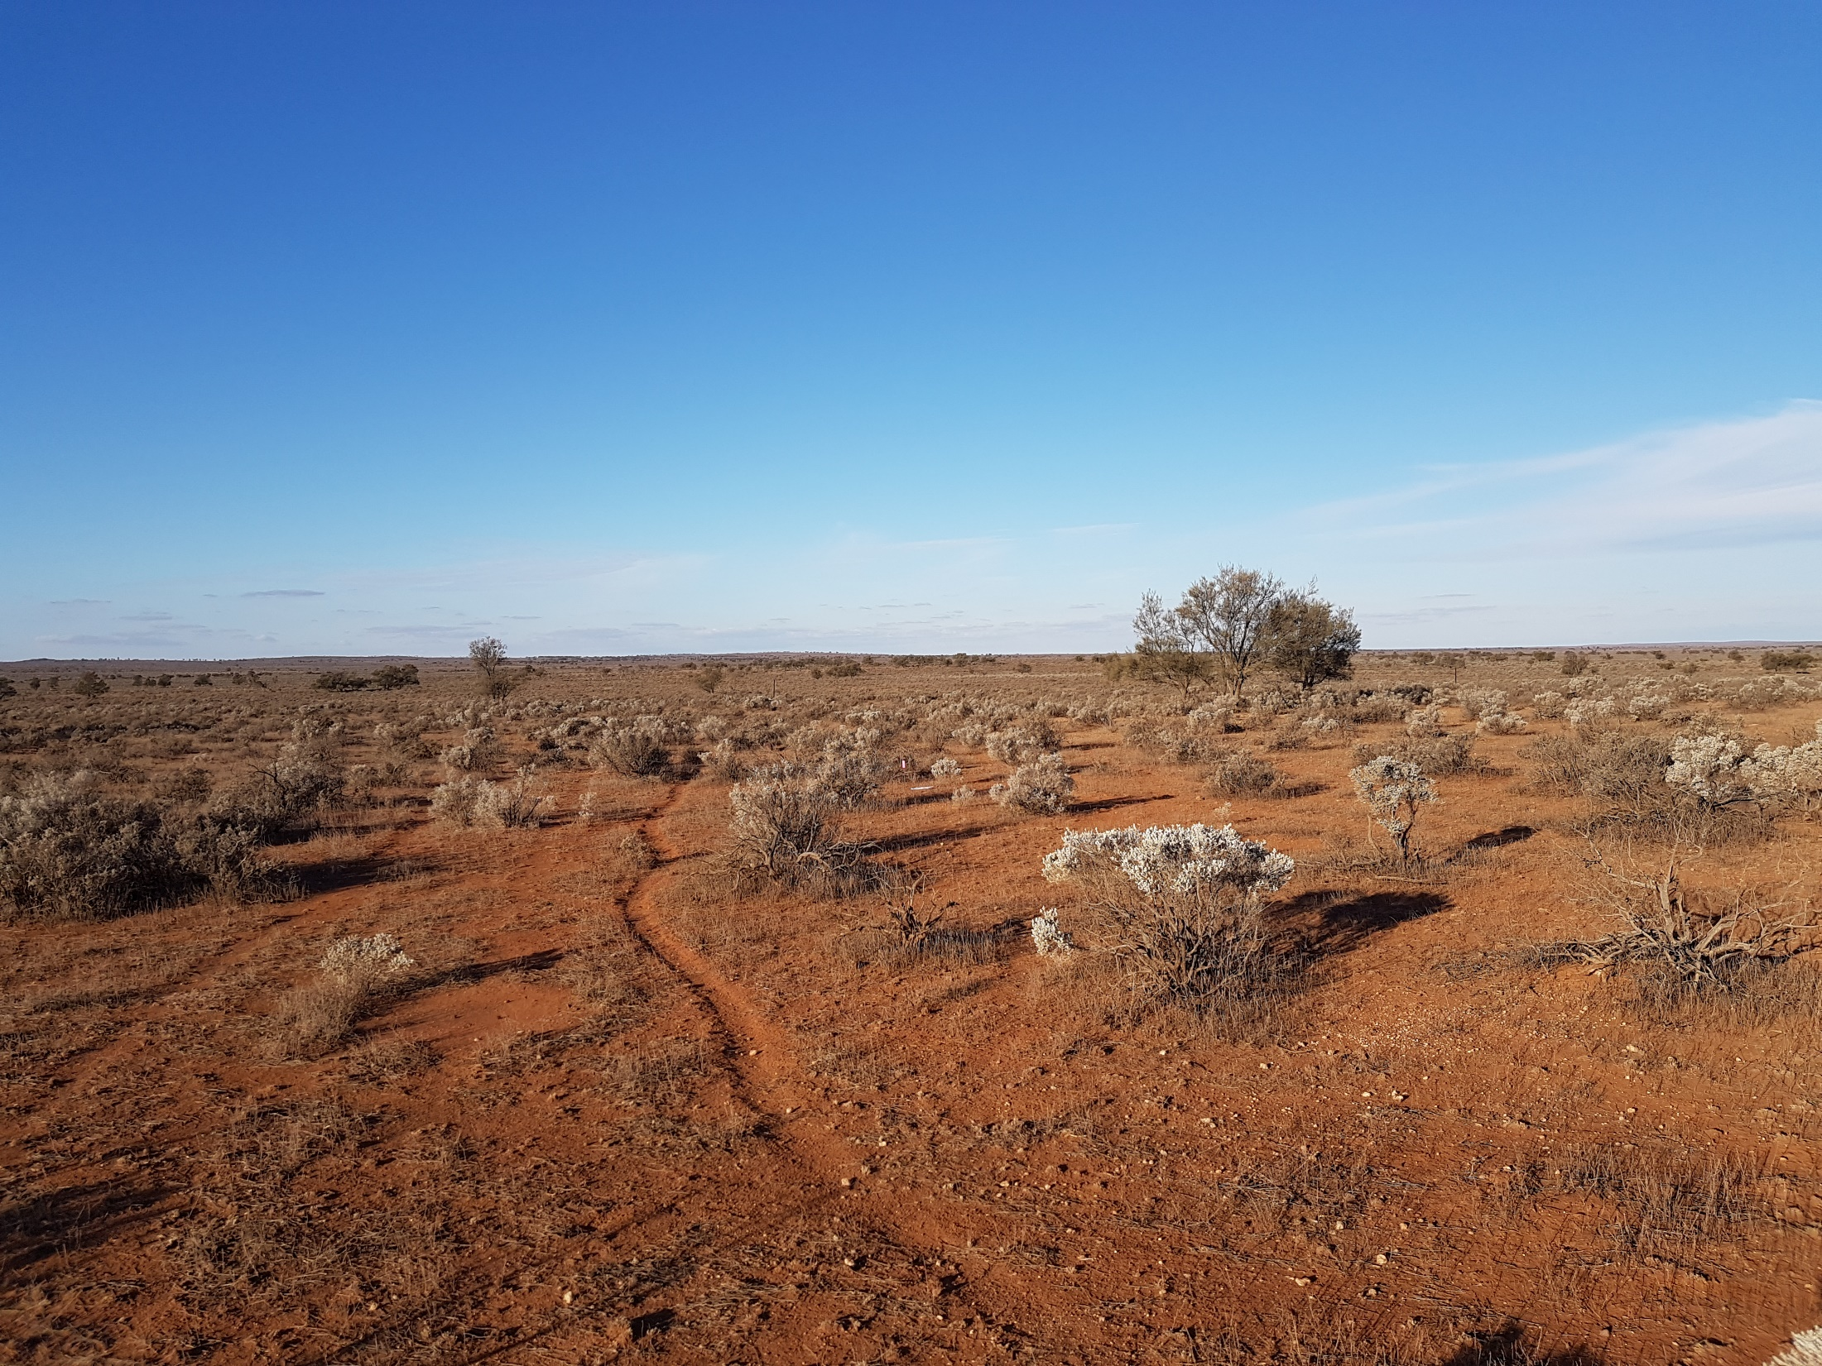
Presentation outline
Regional Setting
Local Geology
Rocks and Structures
Alteration Mineralisation
Model

Slide 3
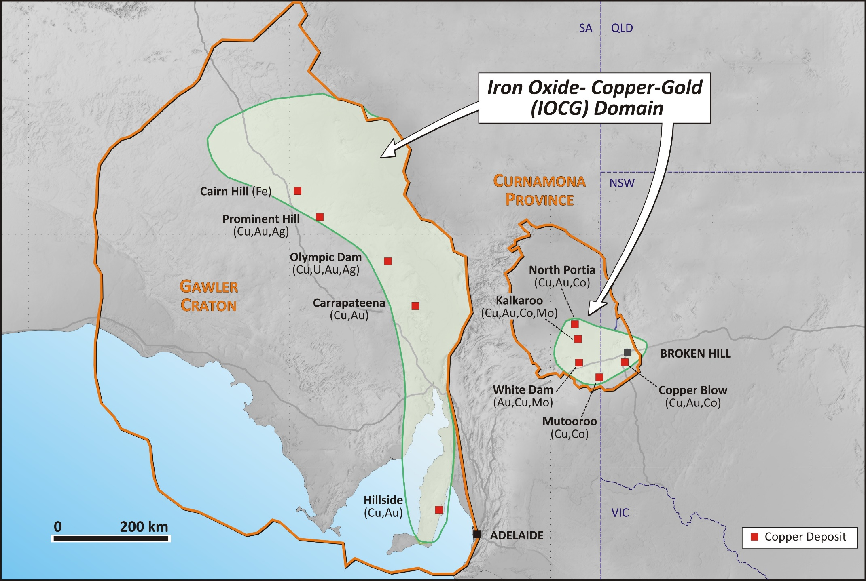

Slide 4
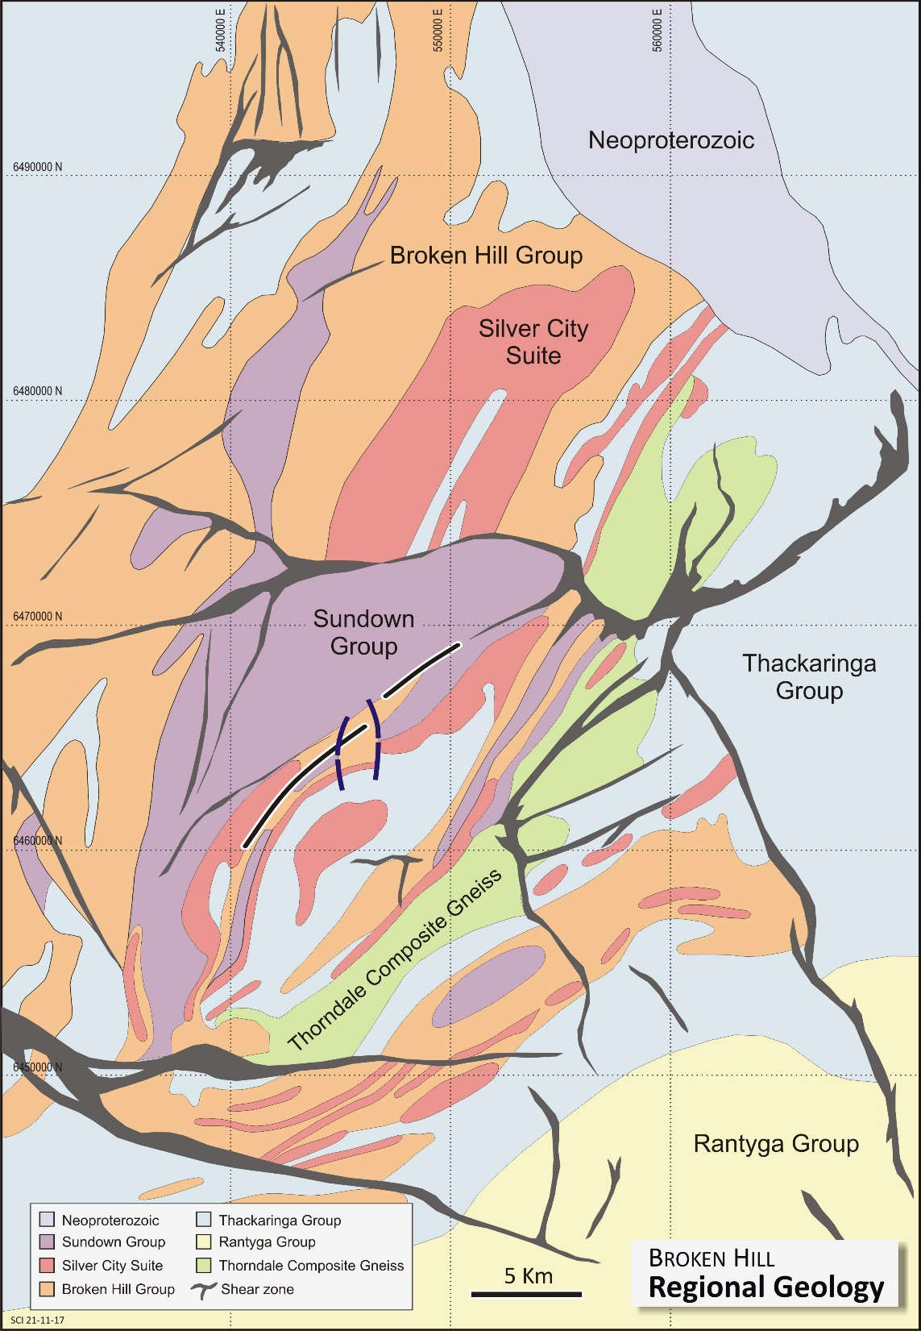
Copper Blow
Hosted in a shear zone close to or on contact between the Thackaringa and Broken Hill Groups. Probably transgresses the contact.
Truncated in the south by Pinnacles Thackaringa Shear zone
Several copper-rich lode horizons
Epigenetic
Shear zone over 4km long; northeast-southwest trend
Strong magnetic anomaly; abundant magnetite and hematite
Originally tested for U; recent focus has been for Cu-Au
Host rocks are gneissic pelite-psammitic and amphibolite rocks with distinctive granite-gneiss on NW side of mineralised zone + gabbro
Copper Blow

Slide 5
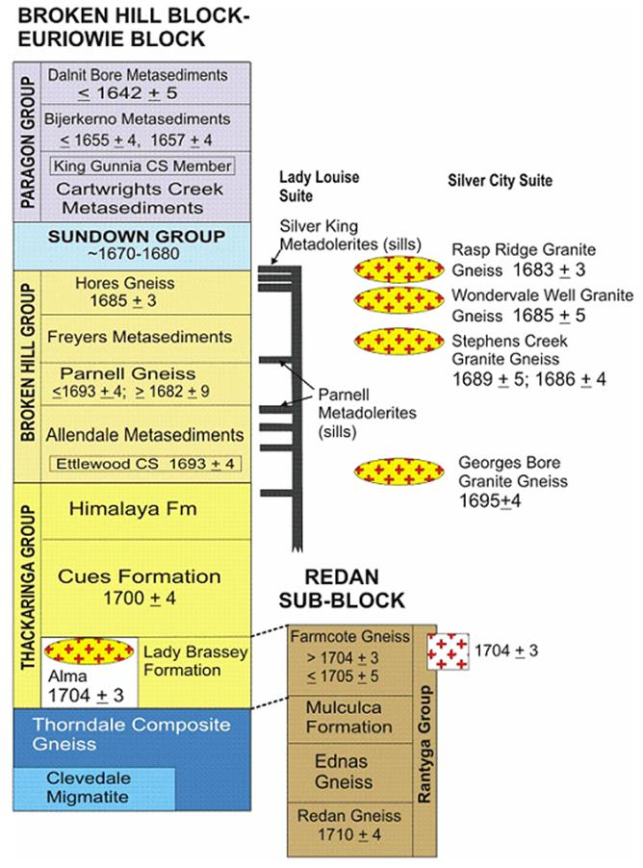
Pb-Zn-Ag Ore Zones
Copper Blow Age?
Copper Blow Position

Slide 6
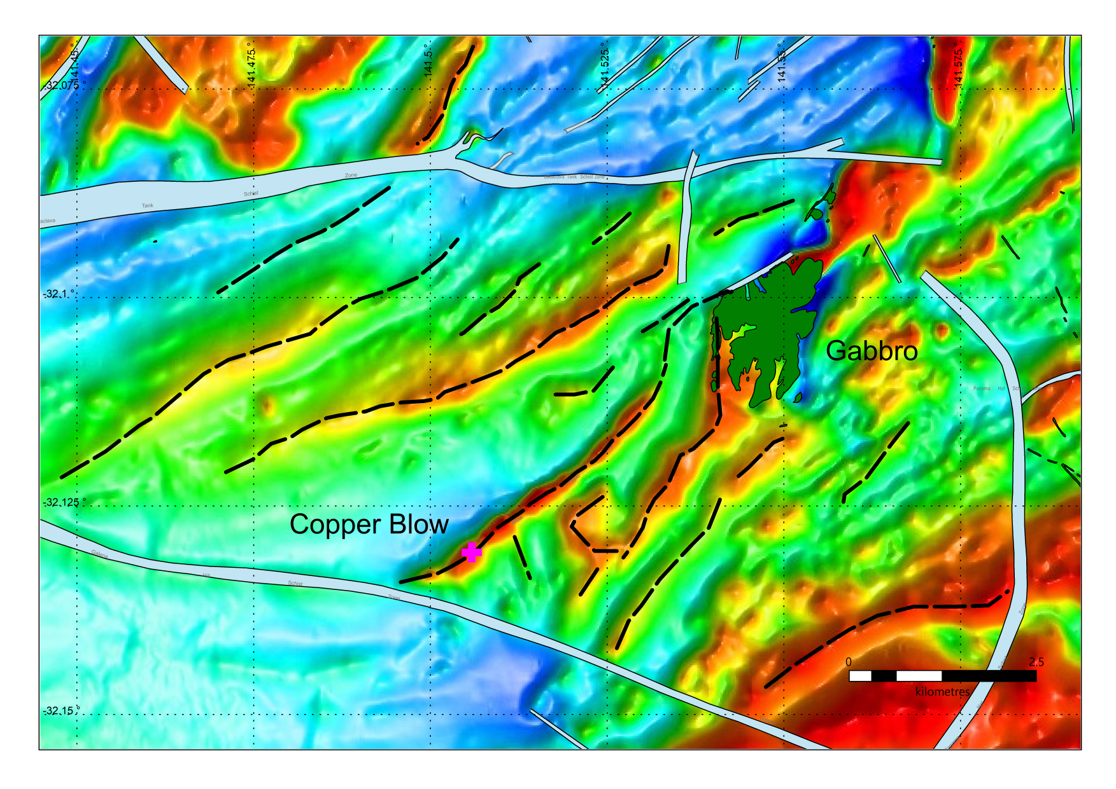
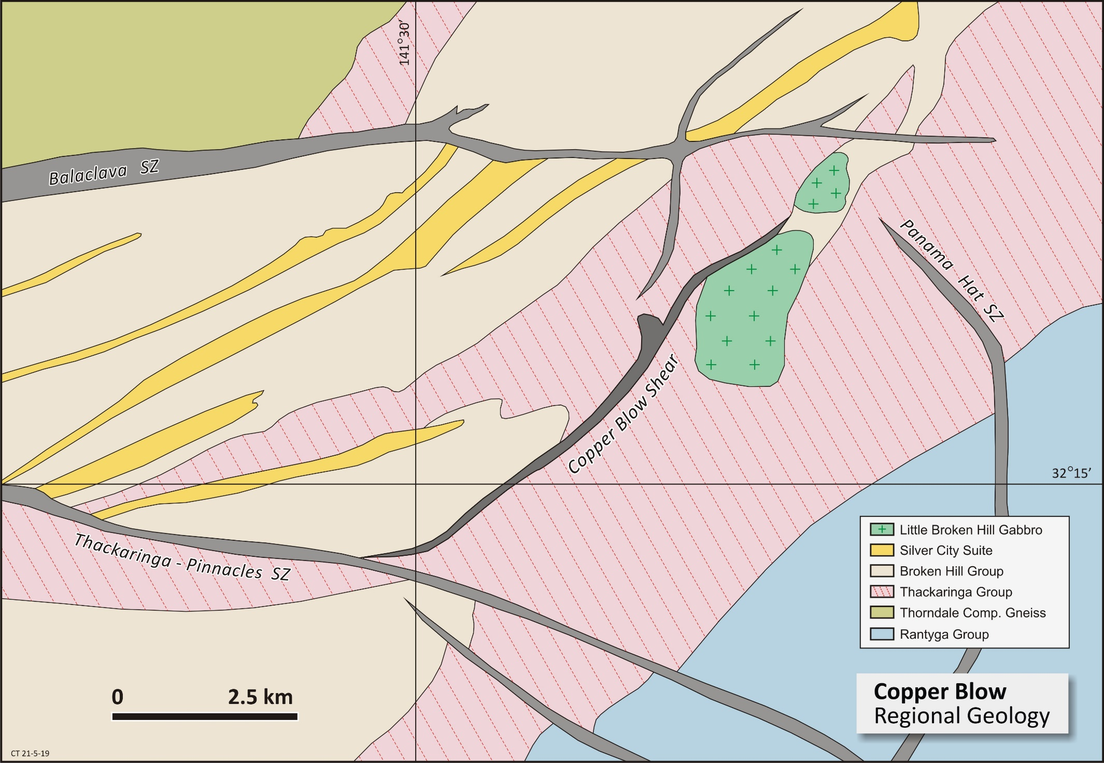
Little Broken Hill Gabbro baddelyite 827+9 Ma, zircon rims (metamorphic) 500+7 Ma.
Copper Blow Drilling

Slide 7
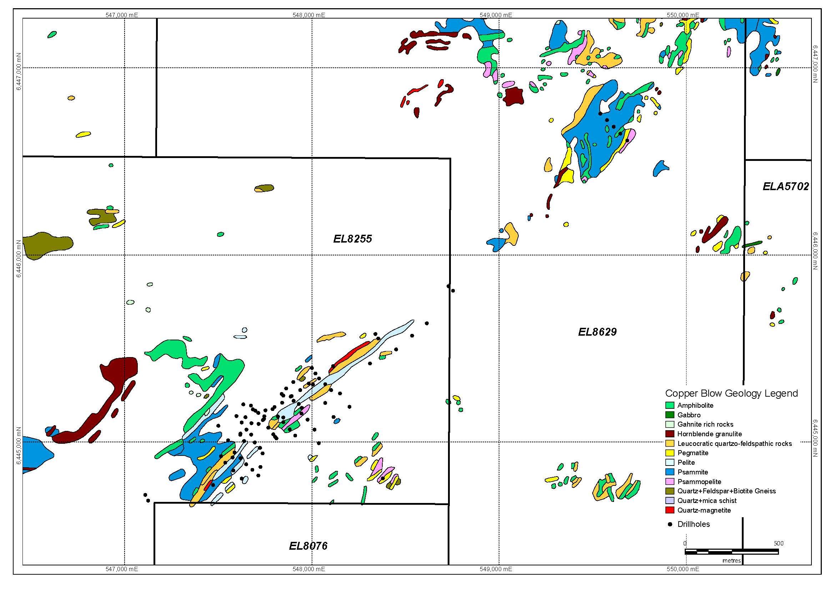

Slide 8
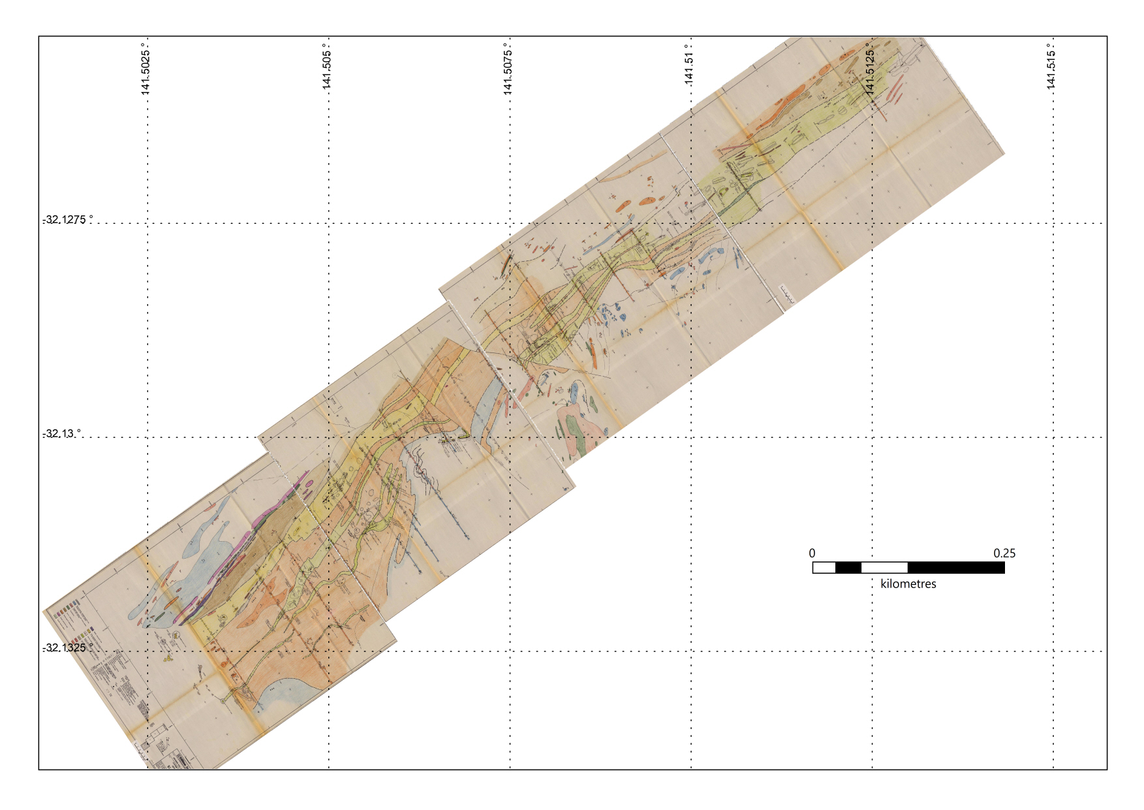
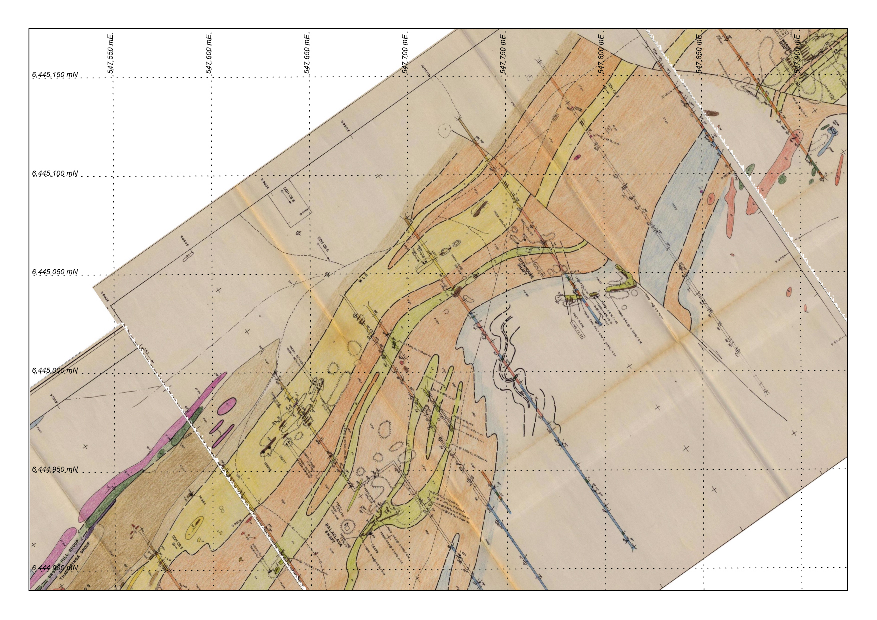
North Zone
South Zone
Dashlooty 1986

Slide 9
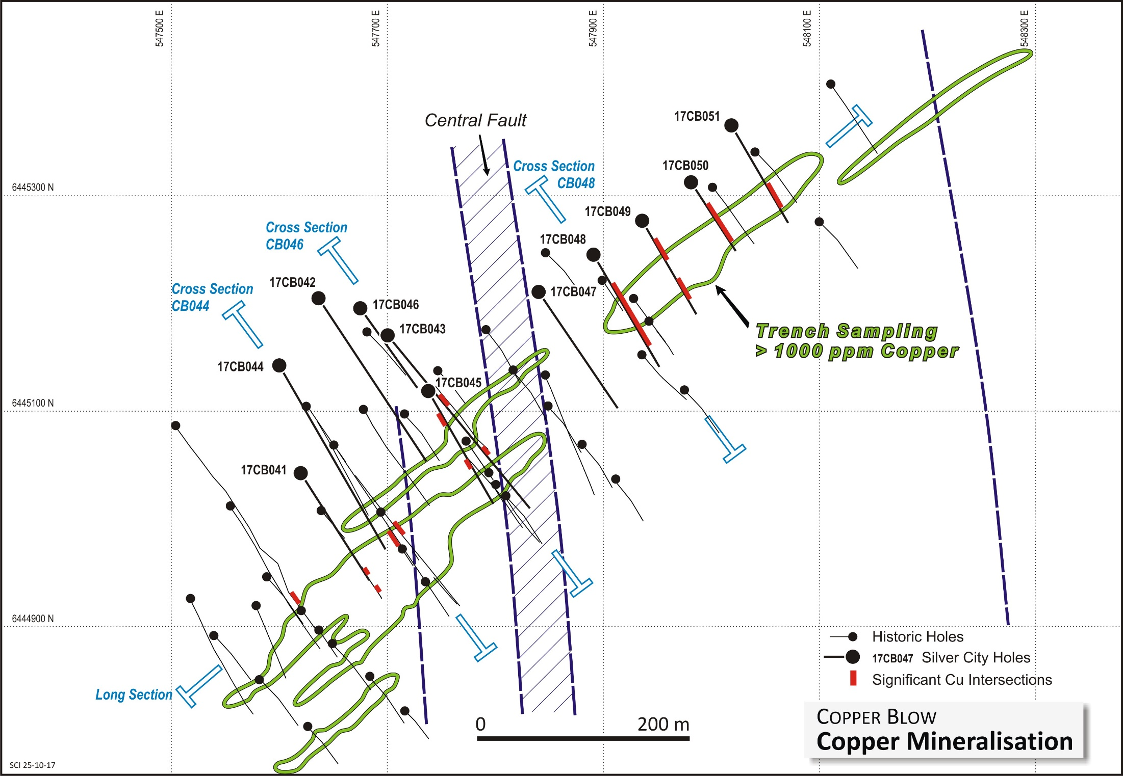
North Zone
South Zone

Slide 10
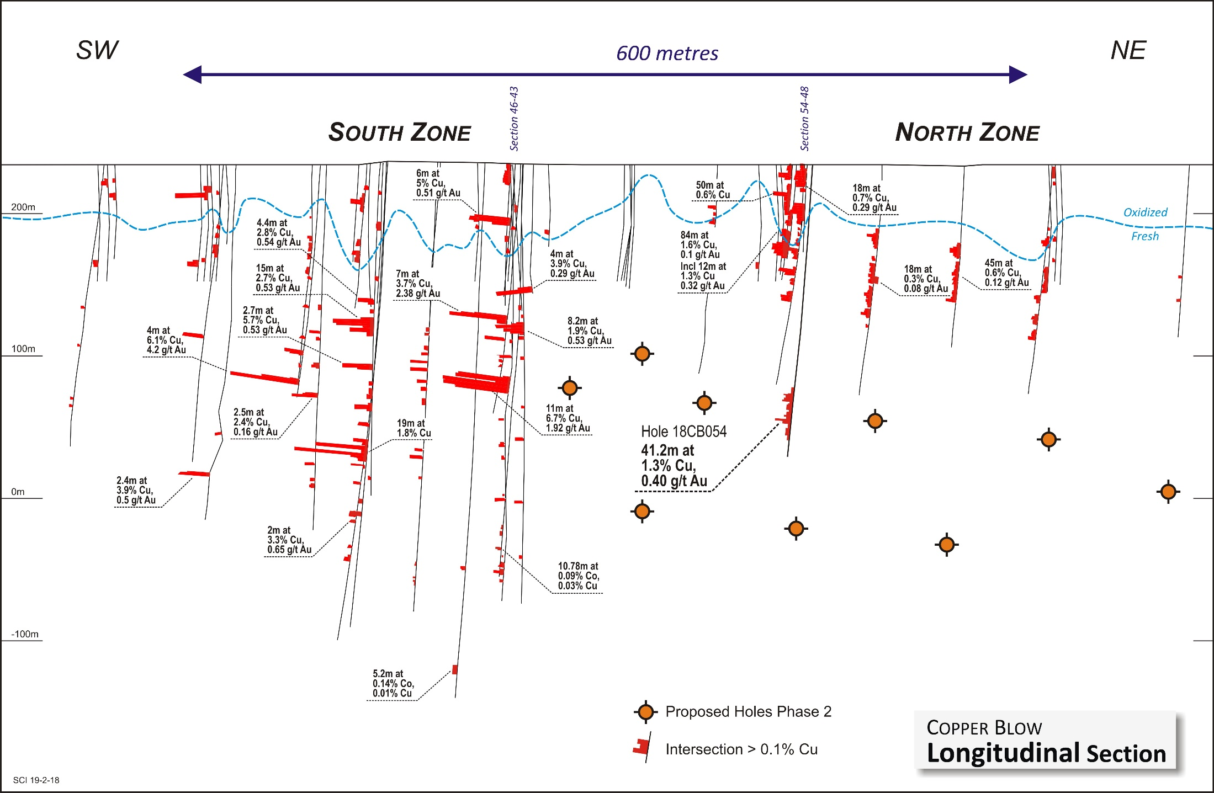
No significant copper
Hole18CB55
61m at 0.7% Cu and 0.14 g/t Au
Hole 18CB057
31m at 1% Cu, 0.26g/t Au
Incl. 15m at 1.6% Cu, o.32g/t Au
No significant copper

Slide 11
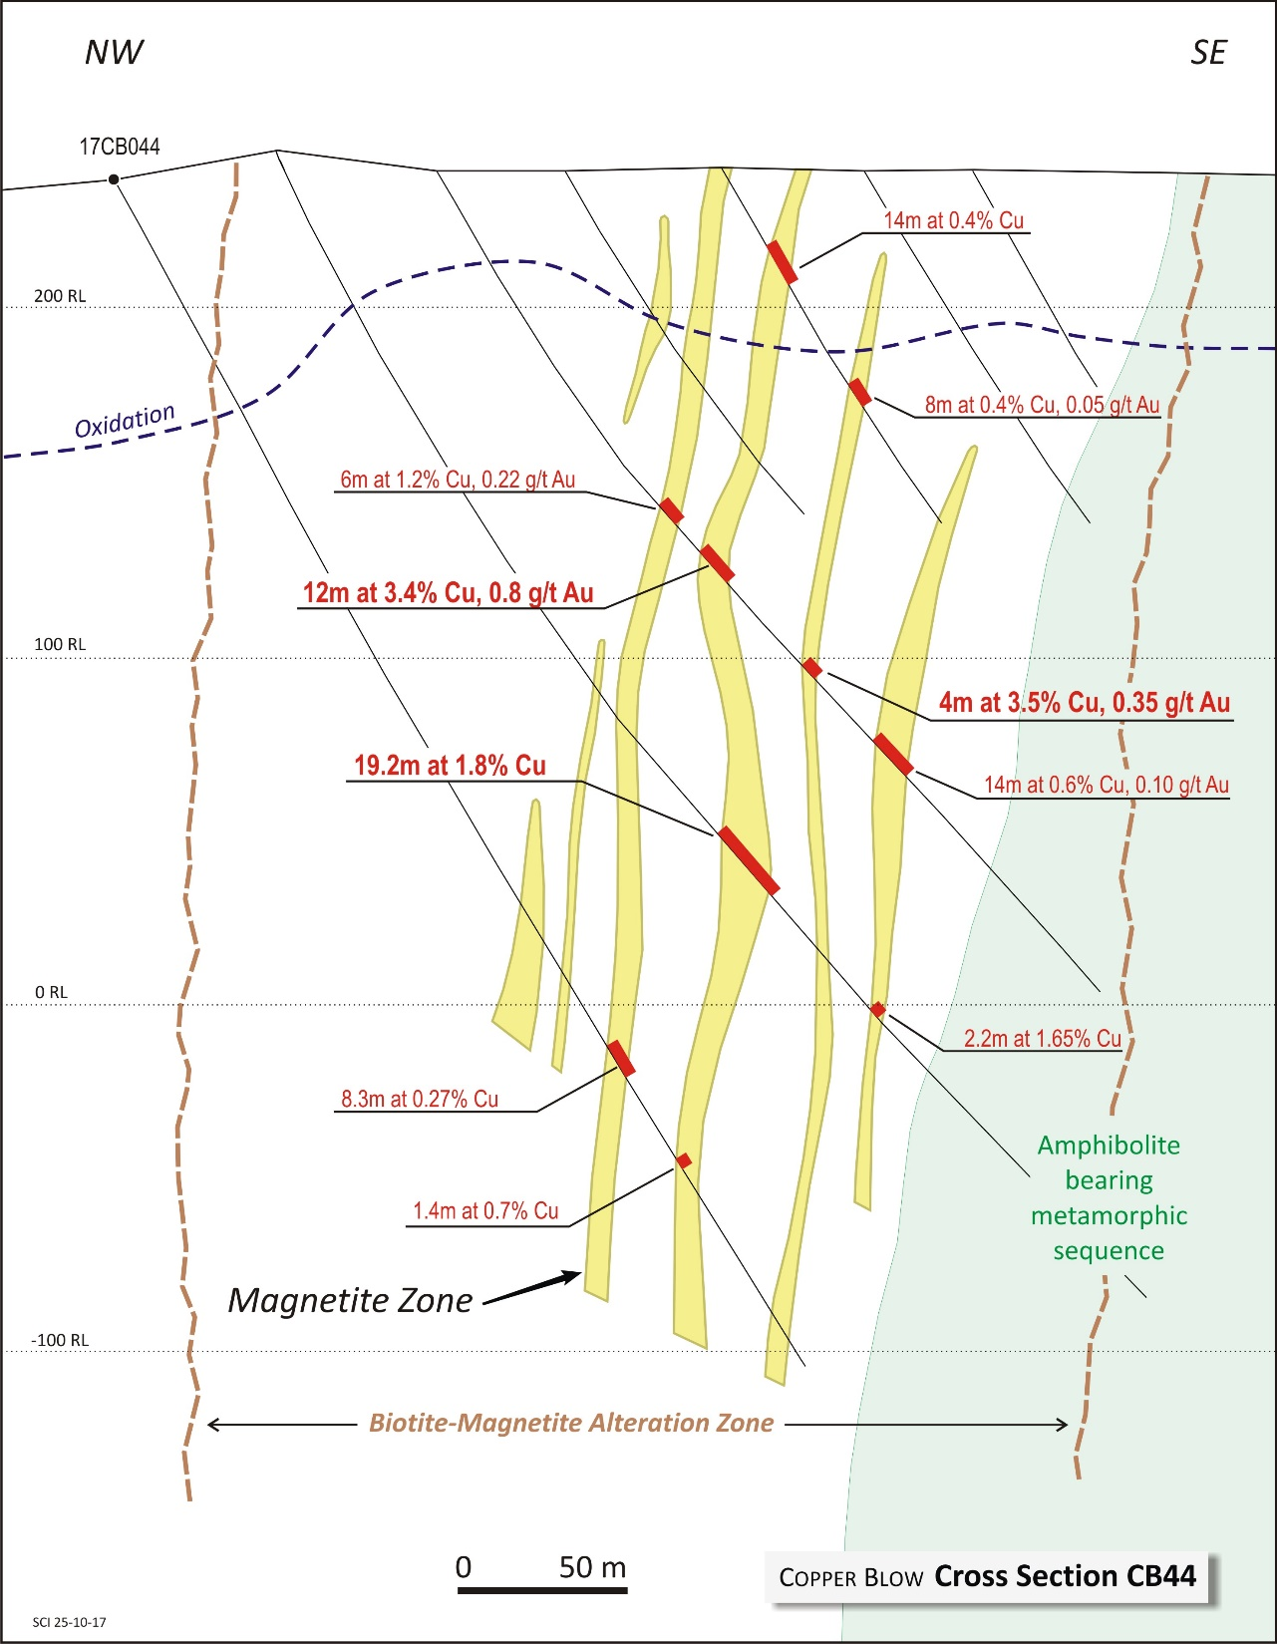

Slide 12
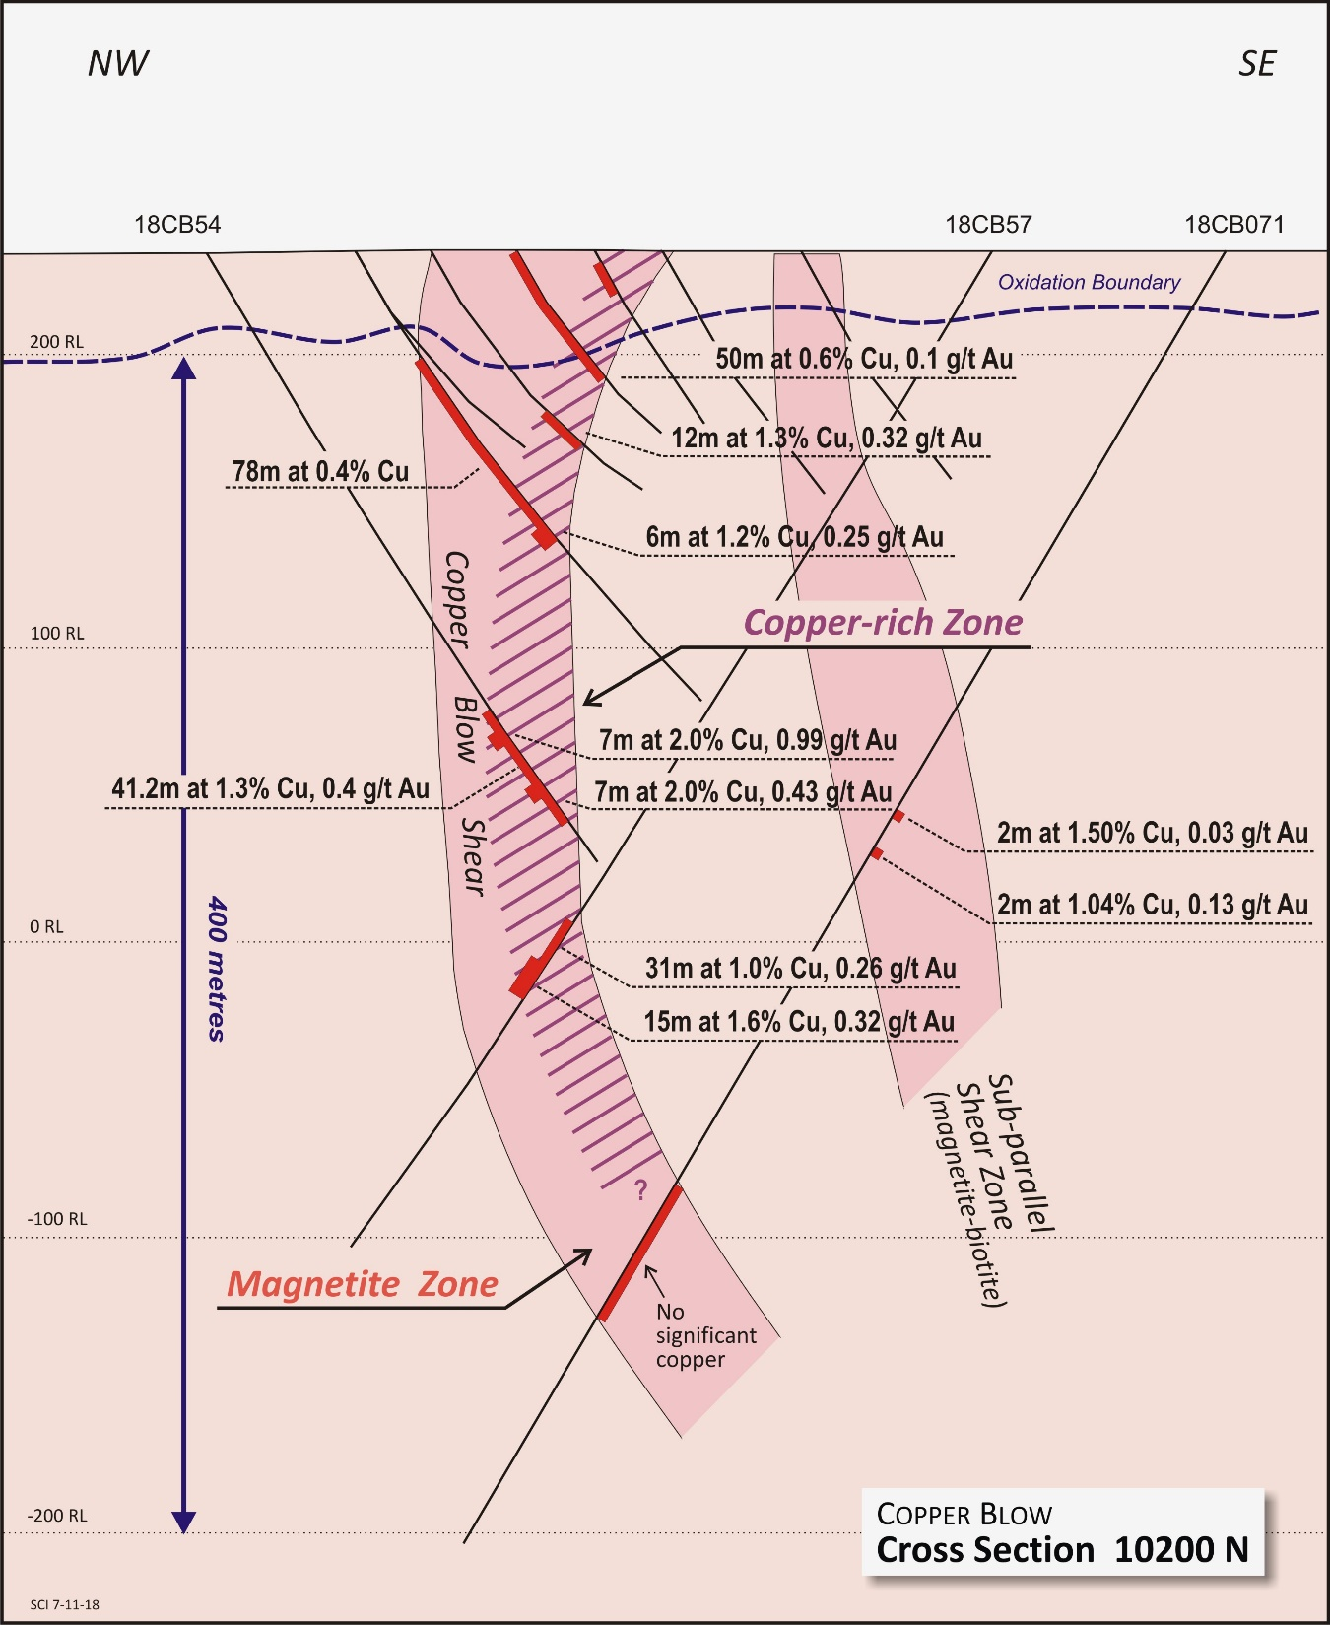

Slide 13
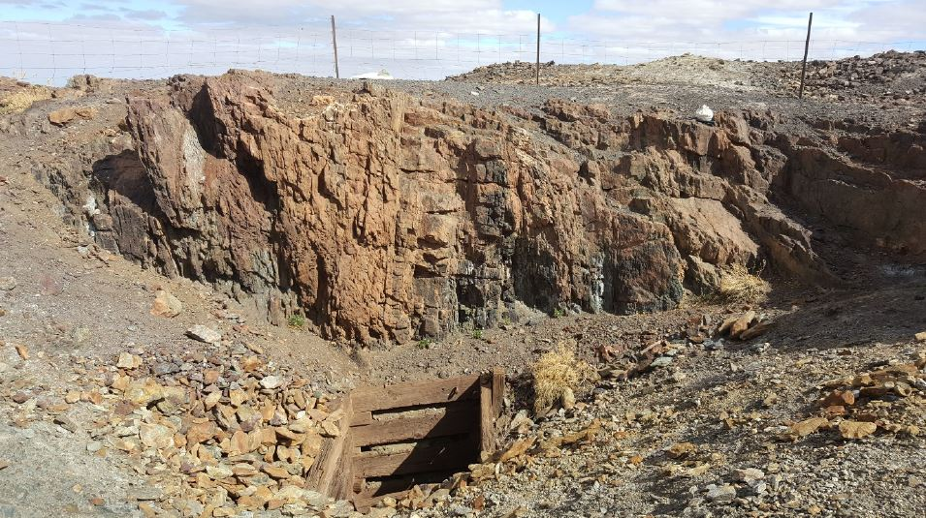

Slide 15
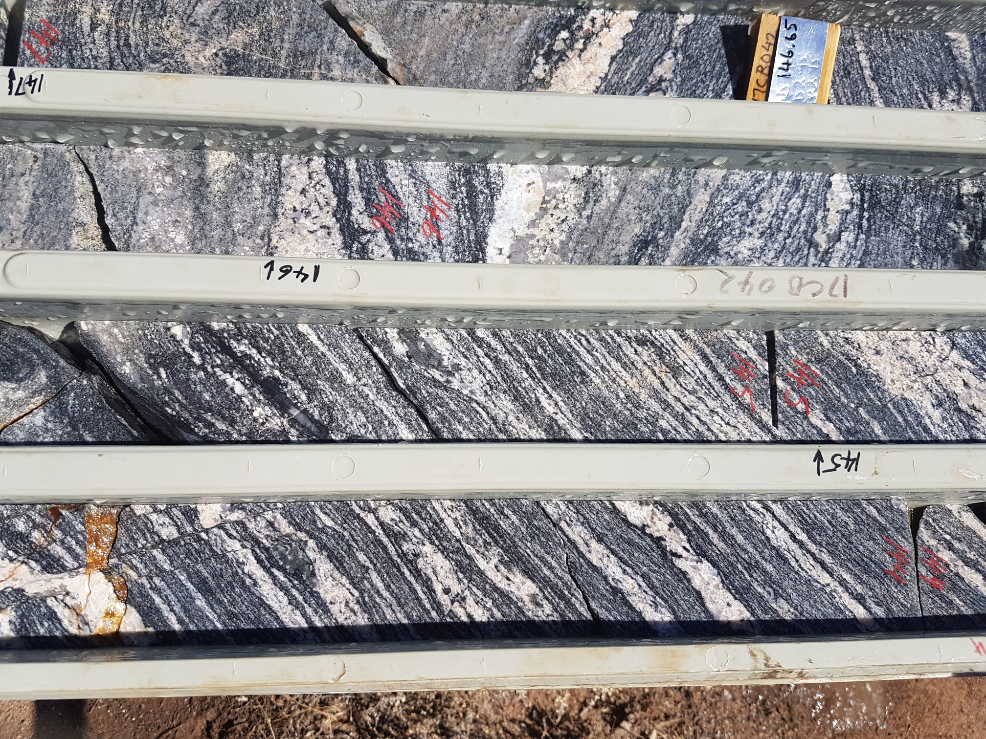

Slide 16
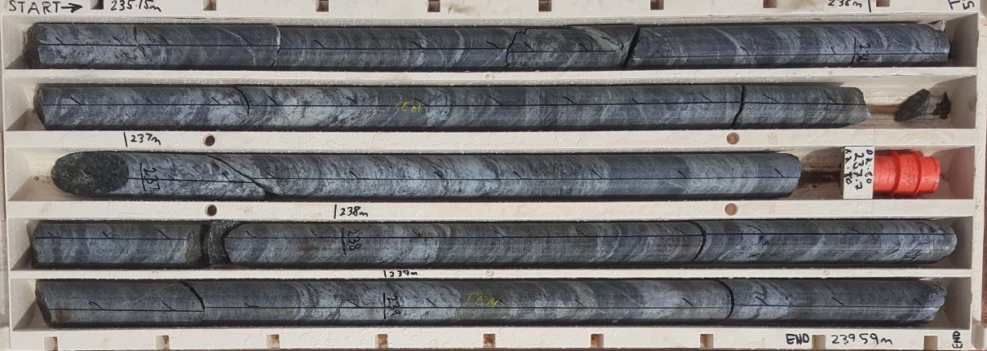
Psammite pelite sequences

Slide 17
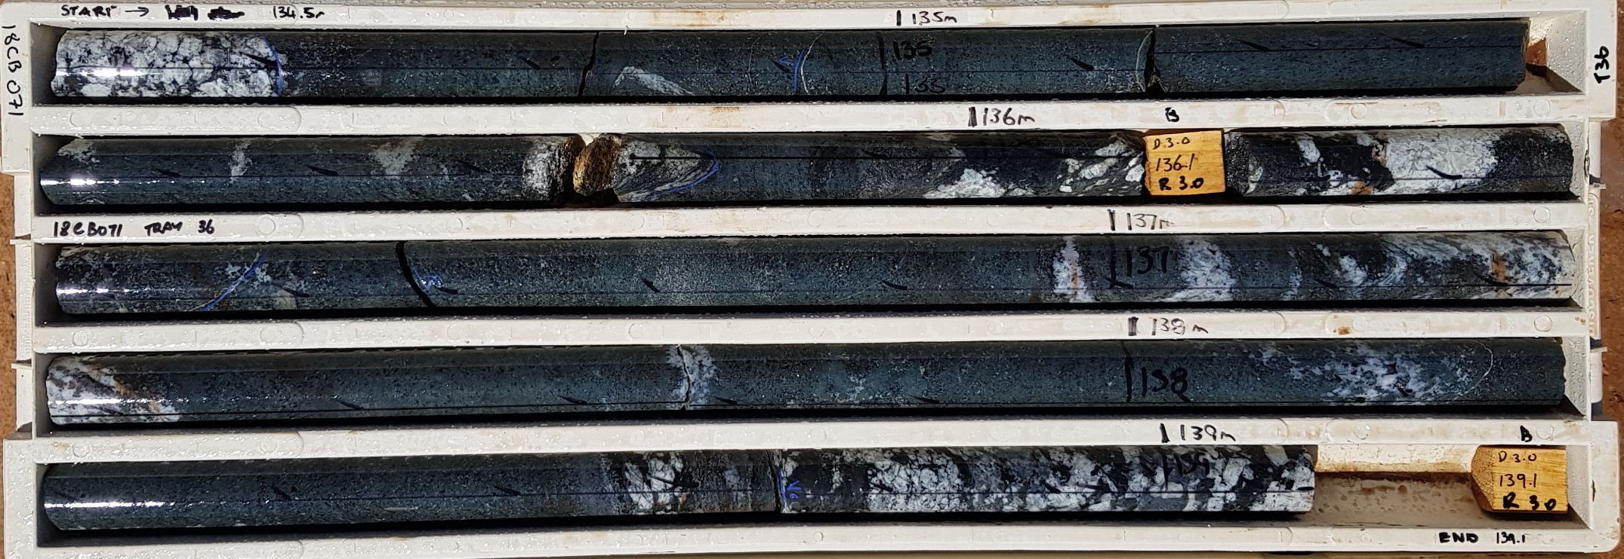
Amphibolite

Slide 18
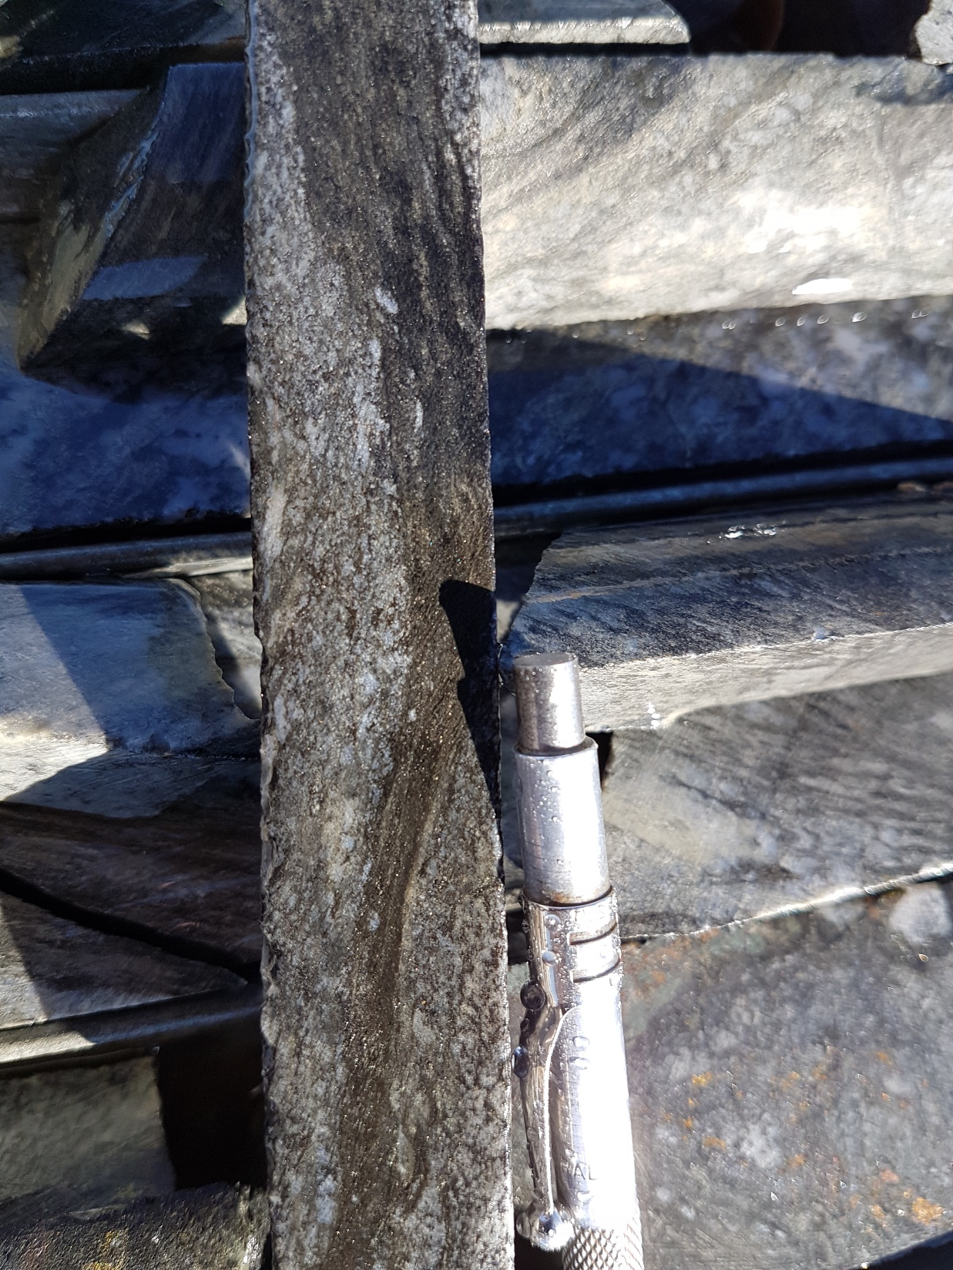
Peripheral Biotite shear zones

Slide 19
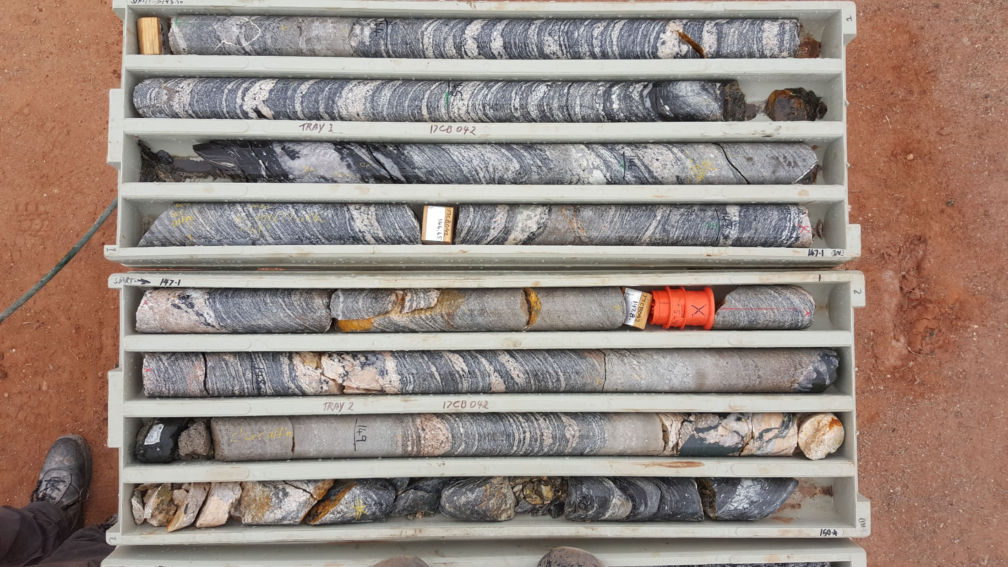

Slide 20
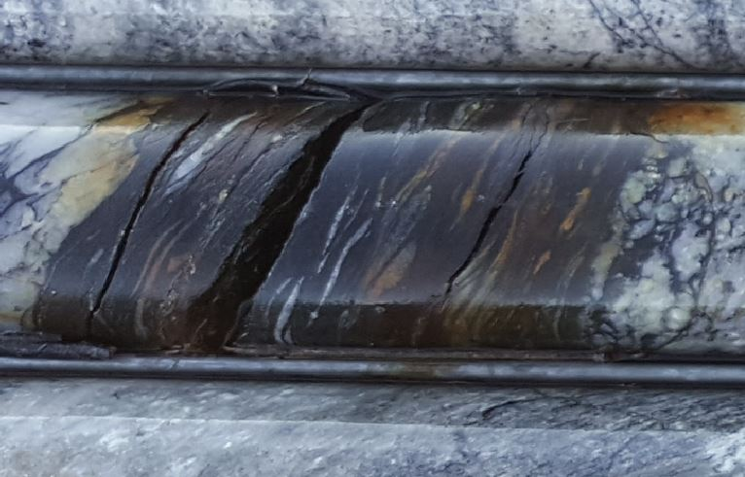
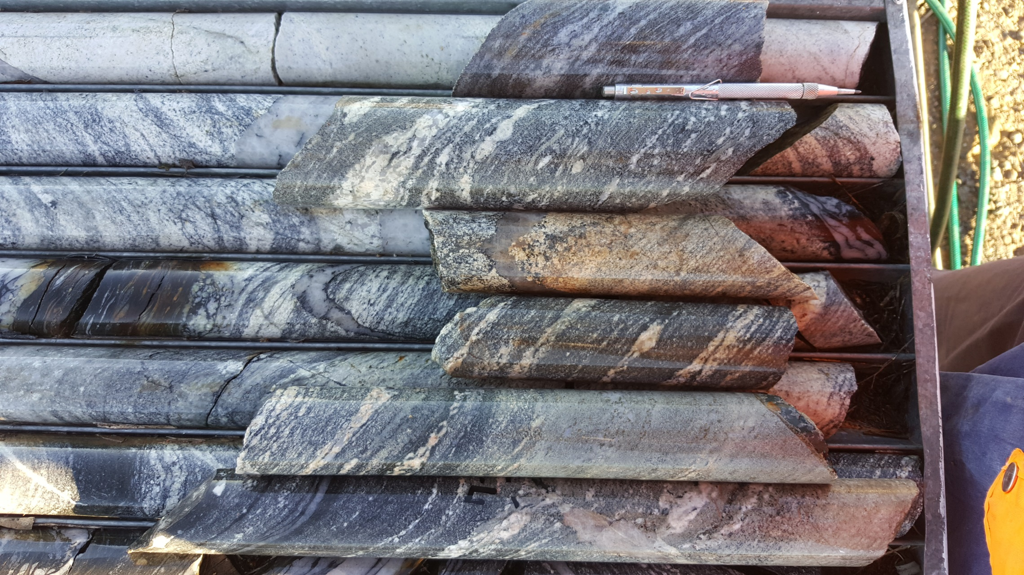

Slide 21
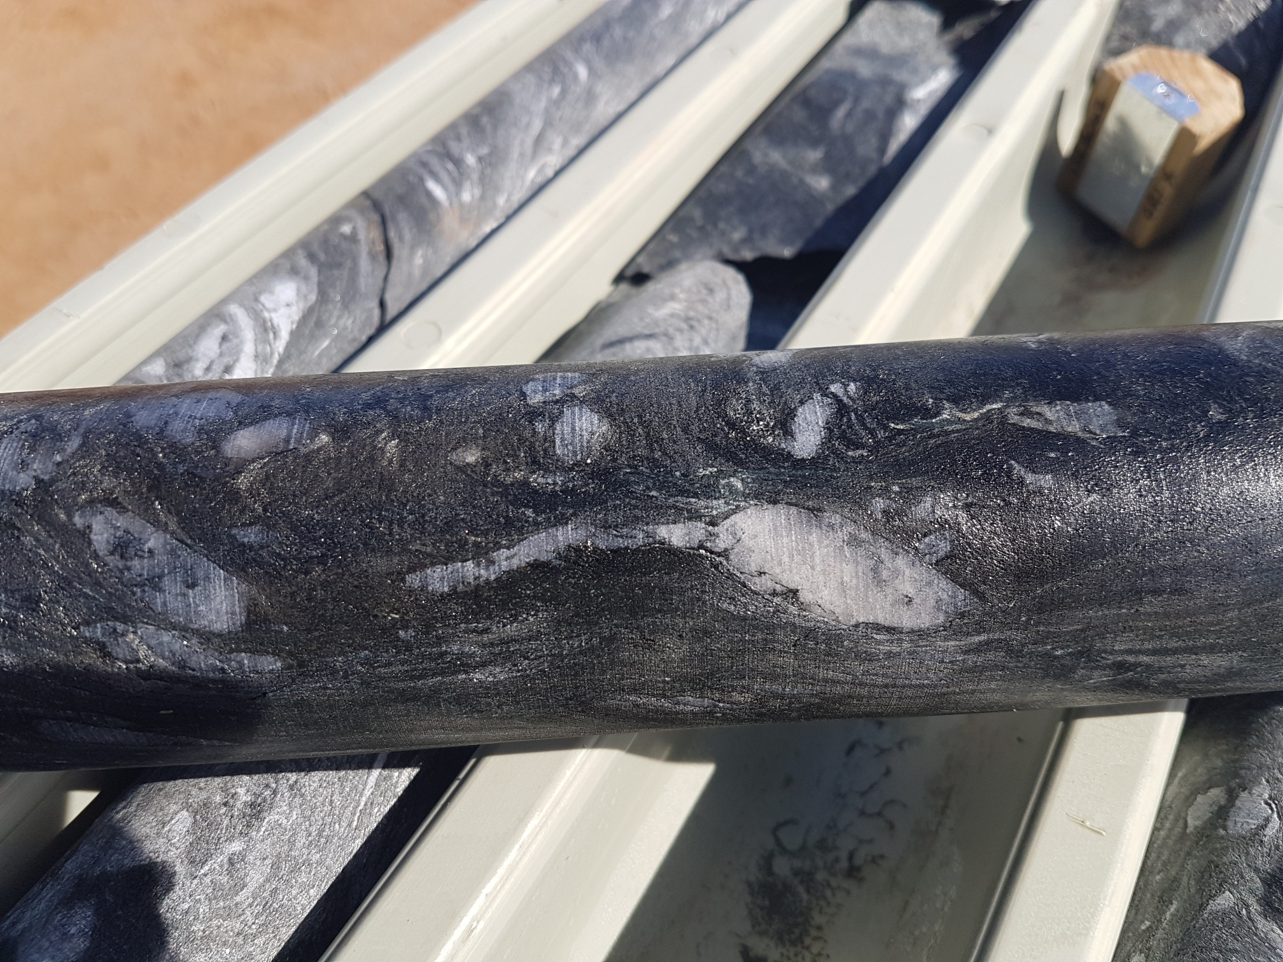

Slide 22
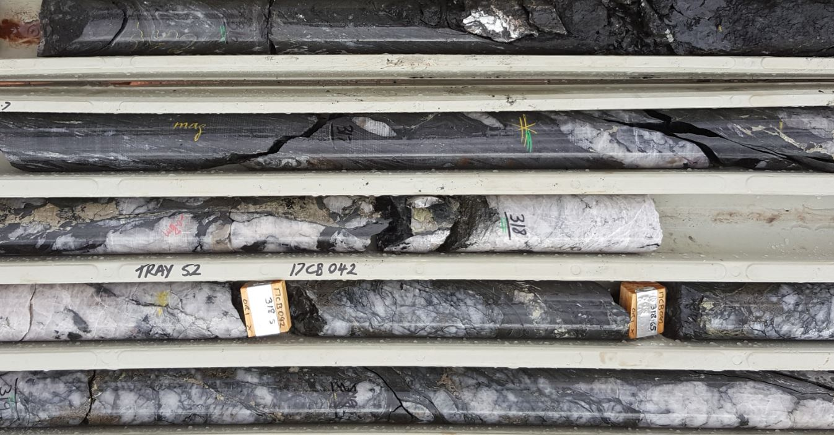

Slide 23
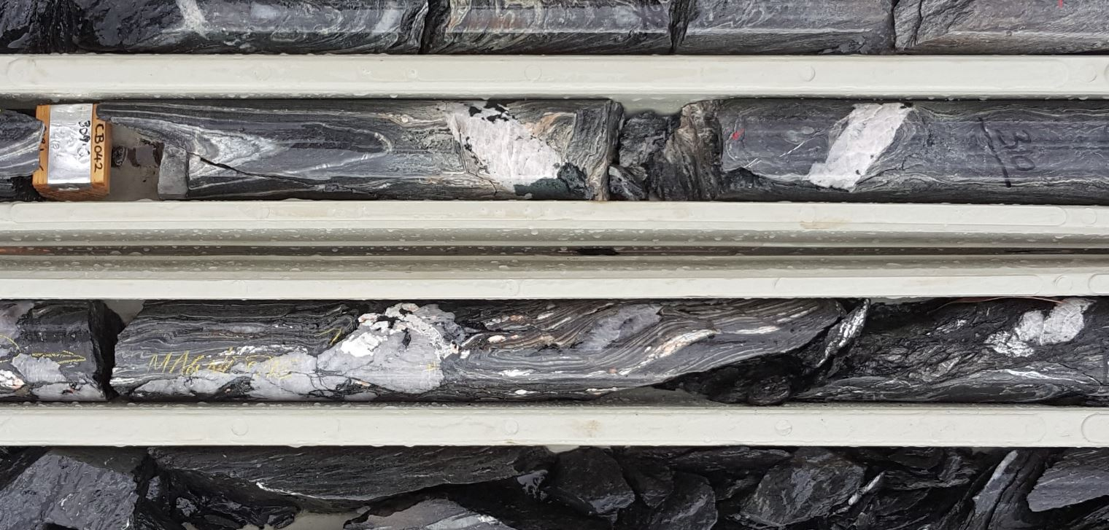

Slide 24
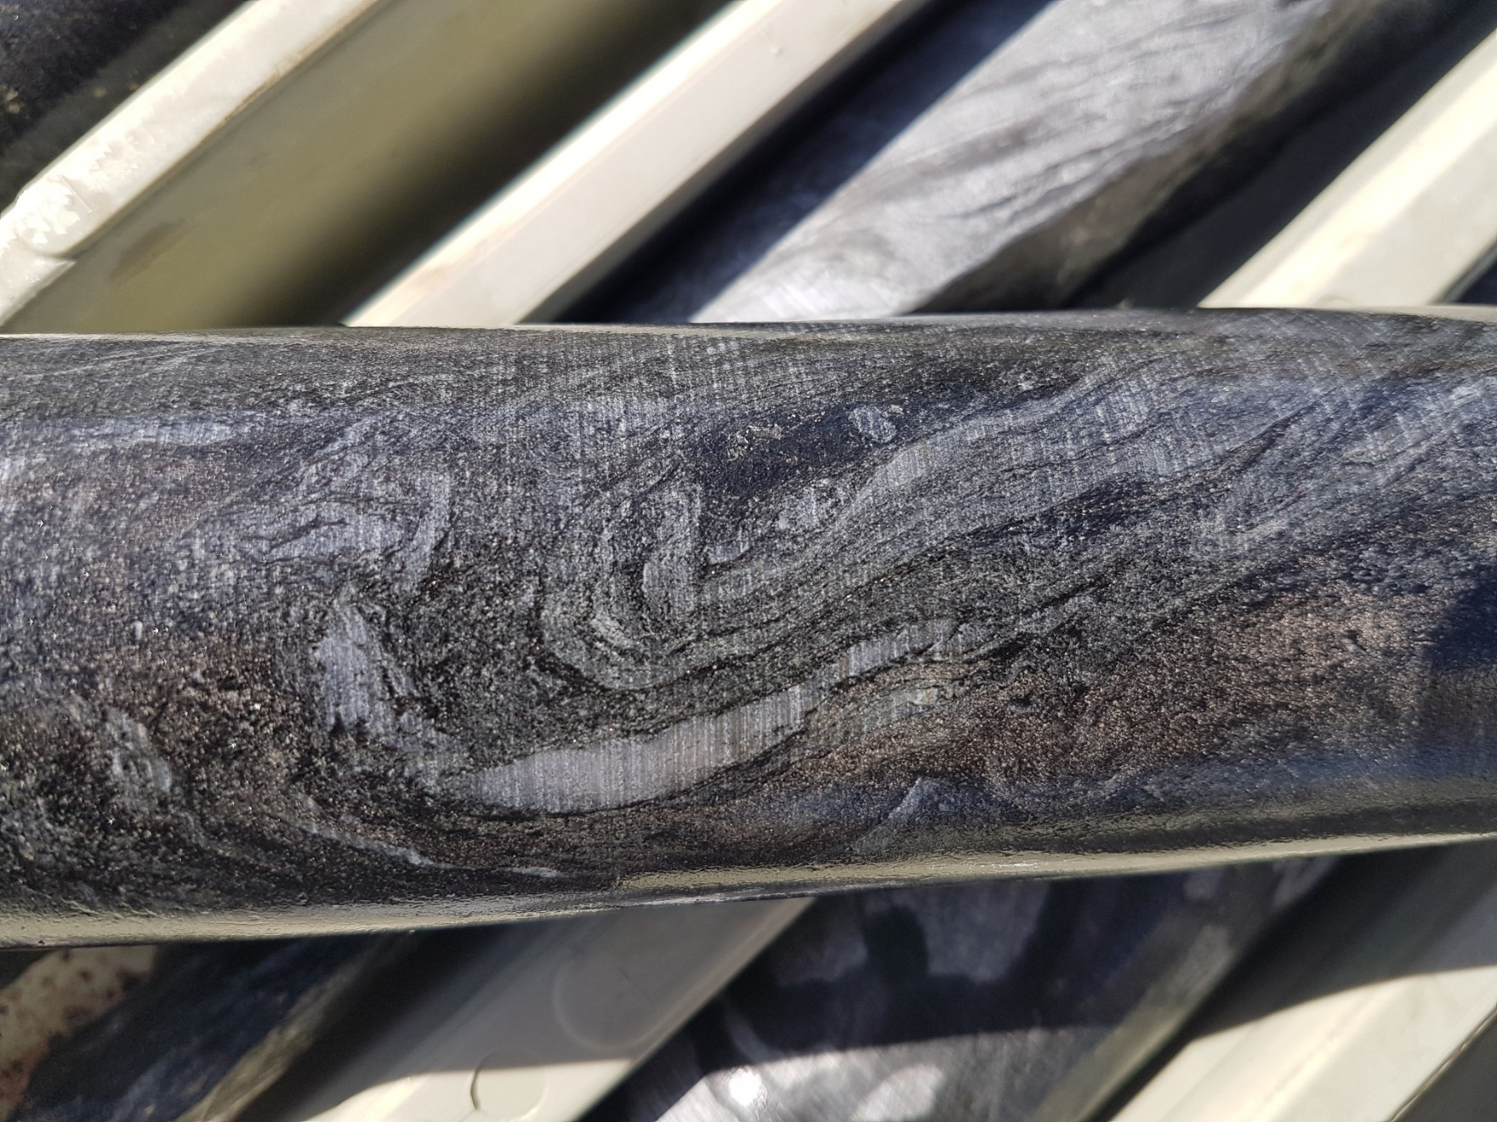
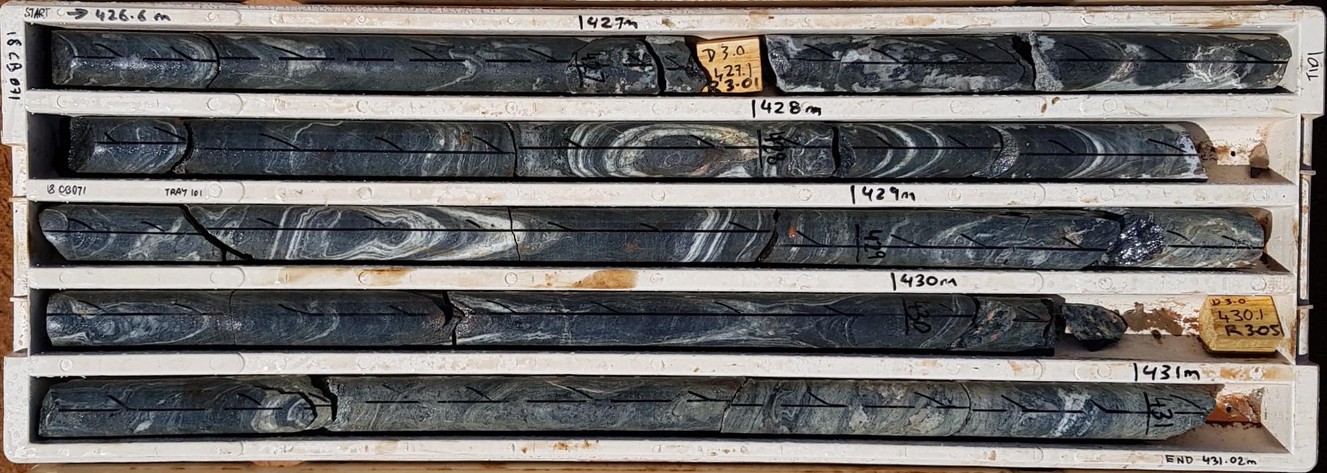

Slide 25
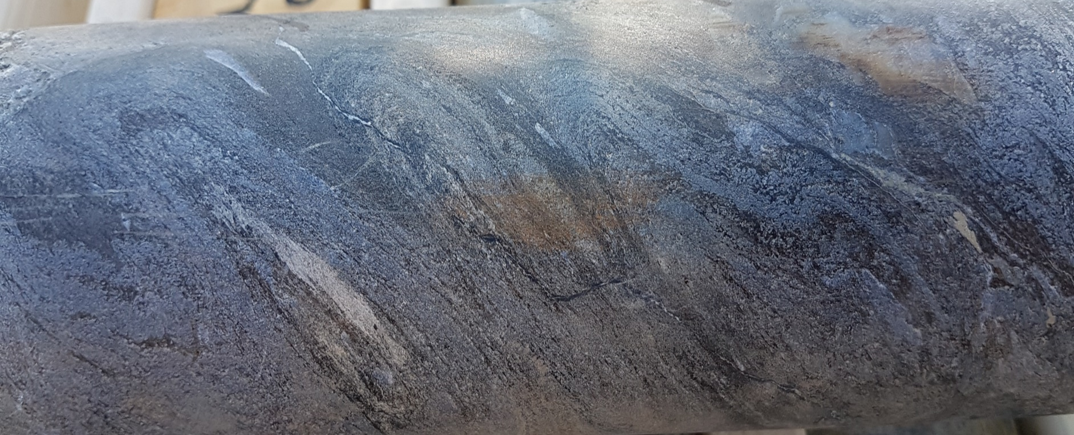
Imbricate structures Short Limb – Long Limb Associated with Shear Related Thrusting

Slide 26
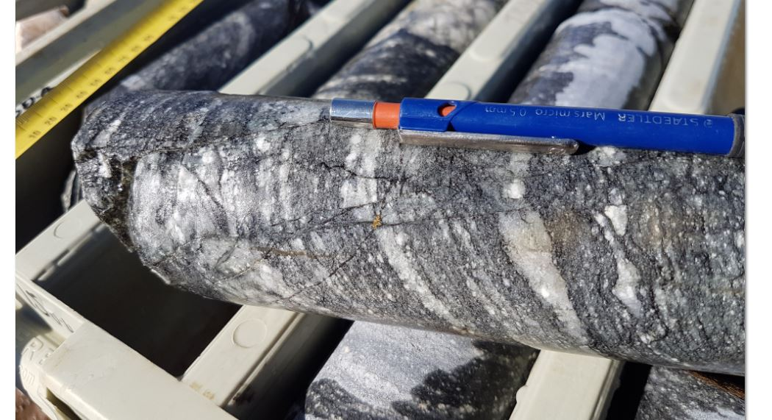

Slide 27
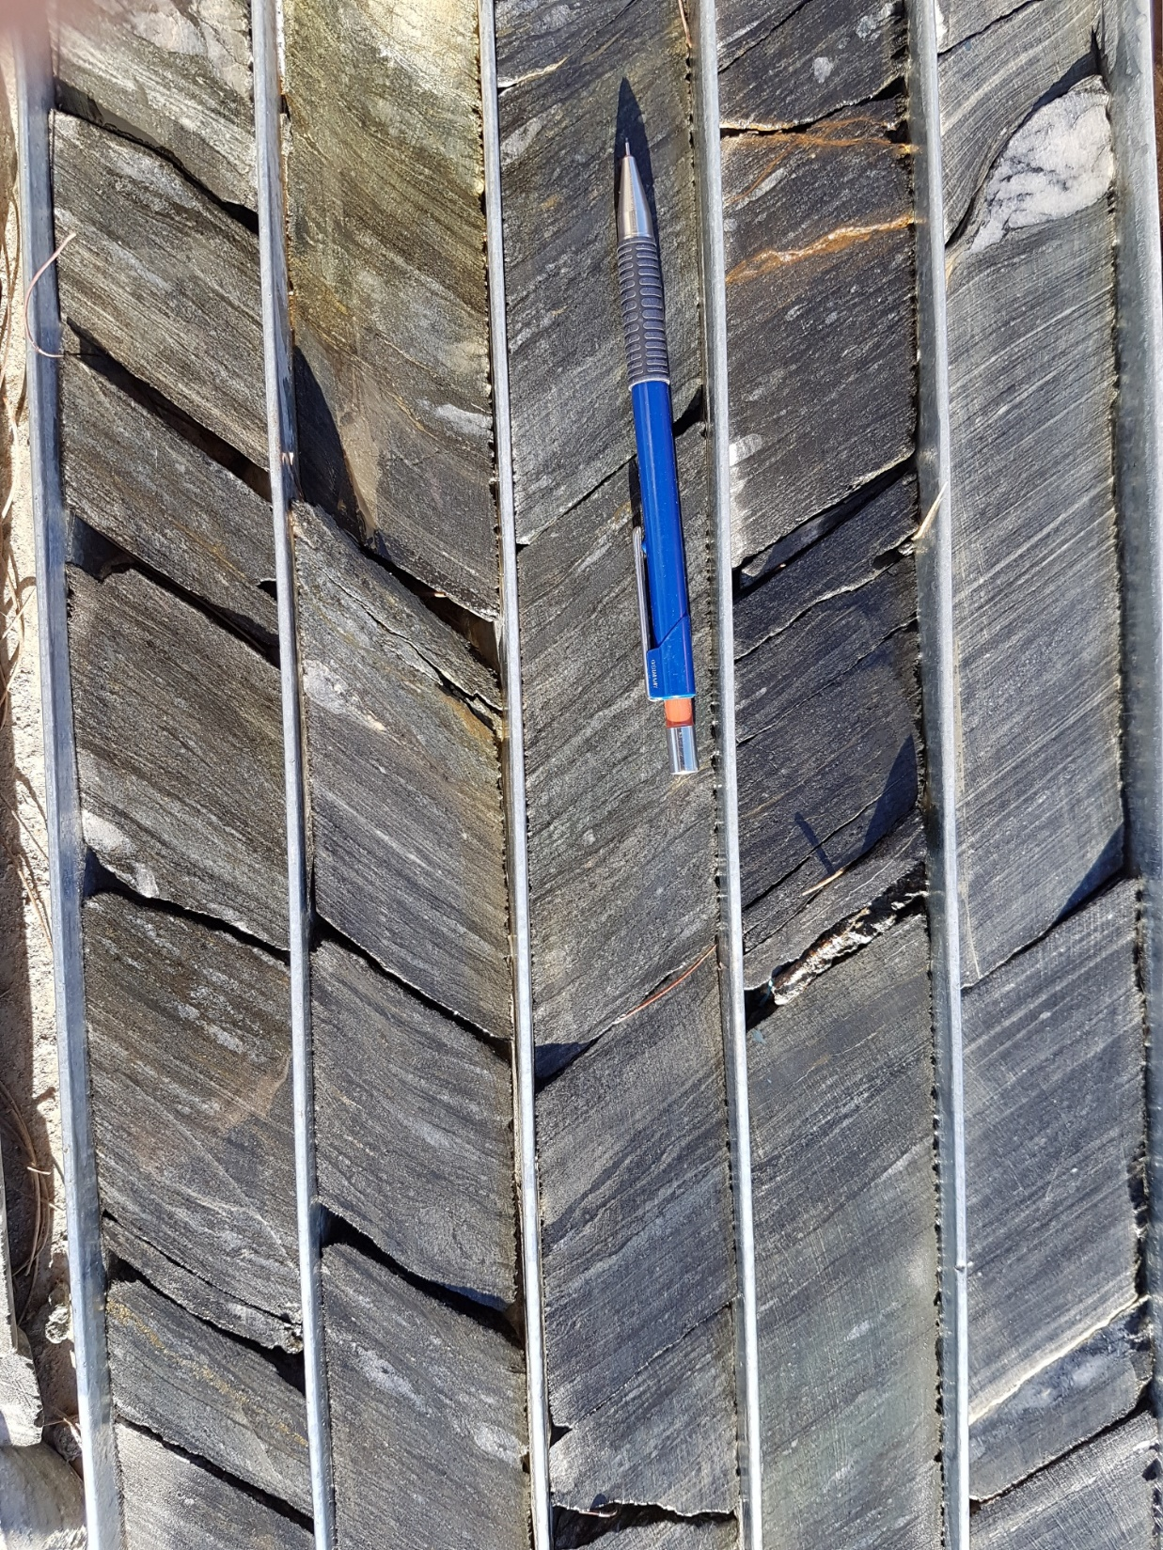
Muscovite overprint

Slide 28
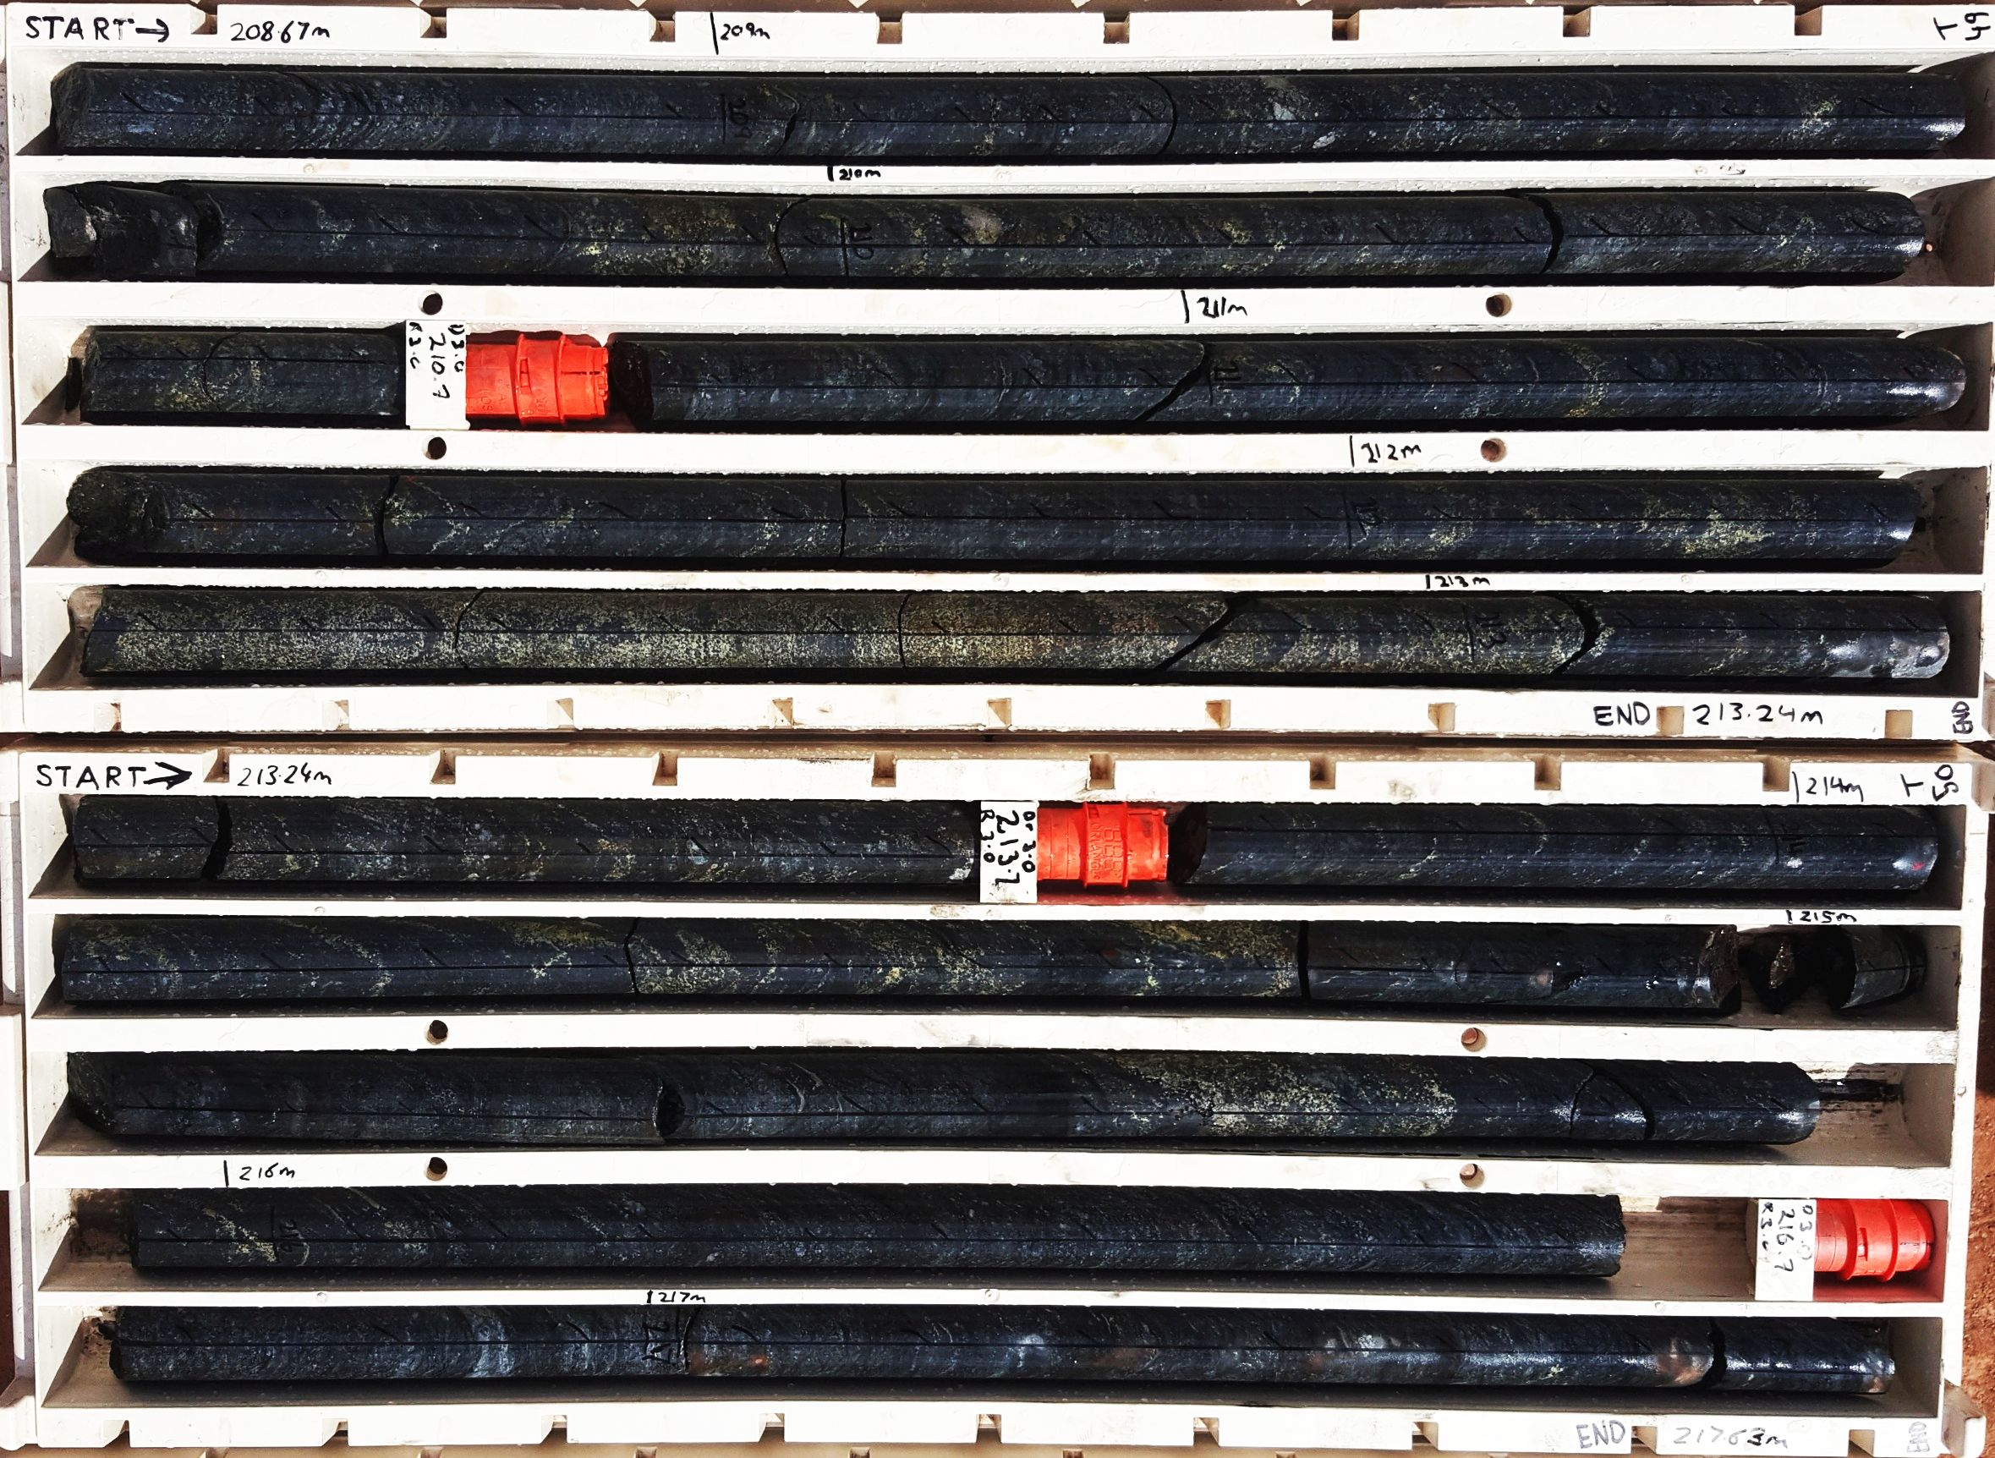
Alteration-Mineralisation
Early
Biotite-kspar-epidote-clinozoizite±titanite-allanite-apatite-scapolite
Magnetite-biotite-quartz-(pyrrhotite-pyrite with Co)±molybdenite±uraninite±chalcopyrite
Late
Quartz-chlorite-epidote-actinolite-carbonate-sericite±k-spar
Chalcopyrite-gold-pyrite±sphalerite±bornite

Slide 29
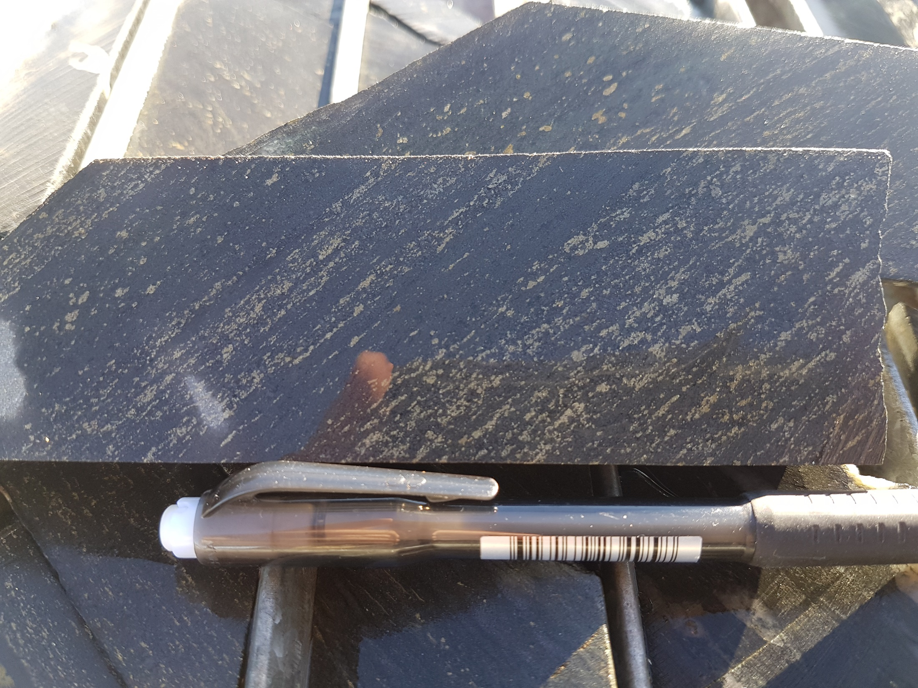

Slide 30
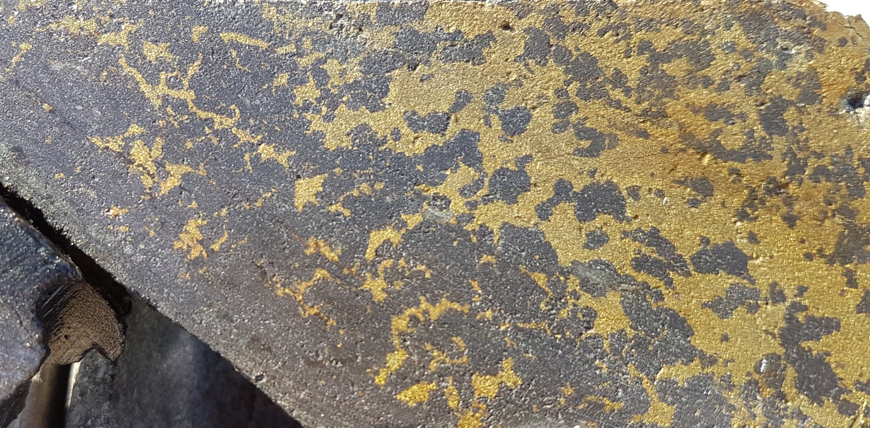
Secondary orthogonal fabric
Primary shear fabric

Slide 31
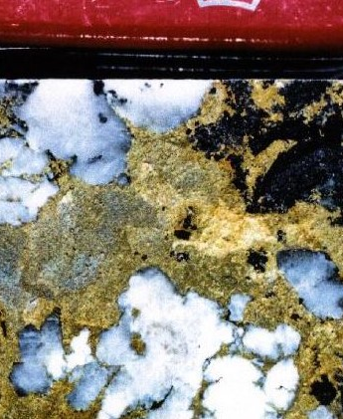
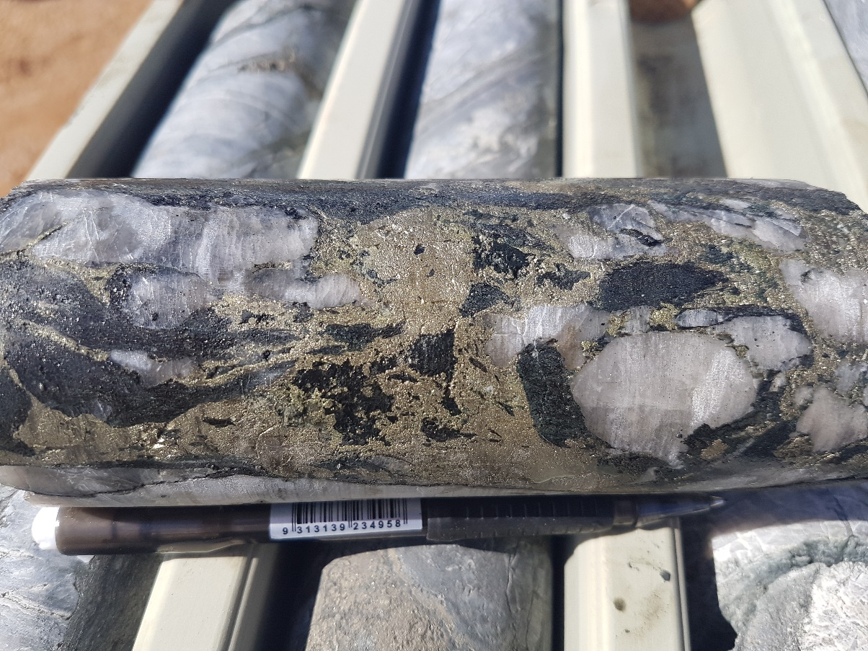
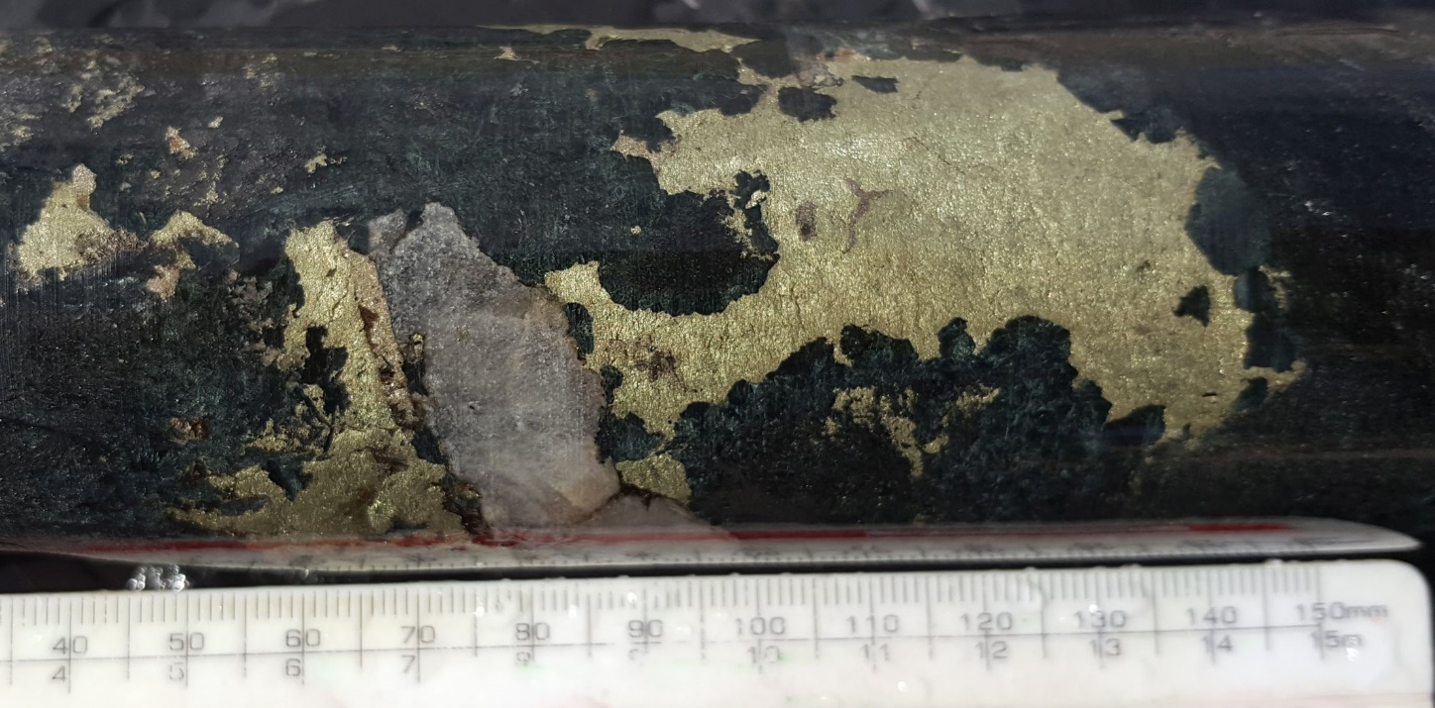

Slide 32
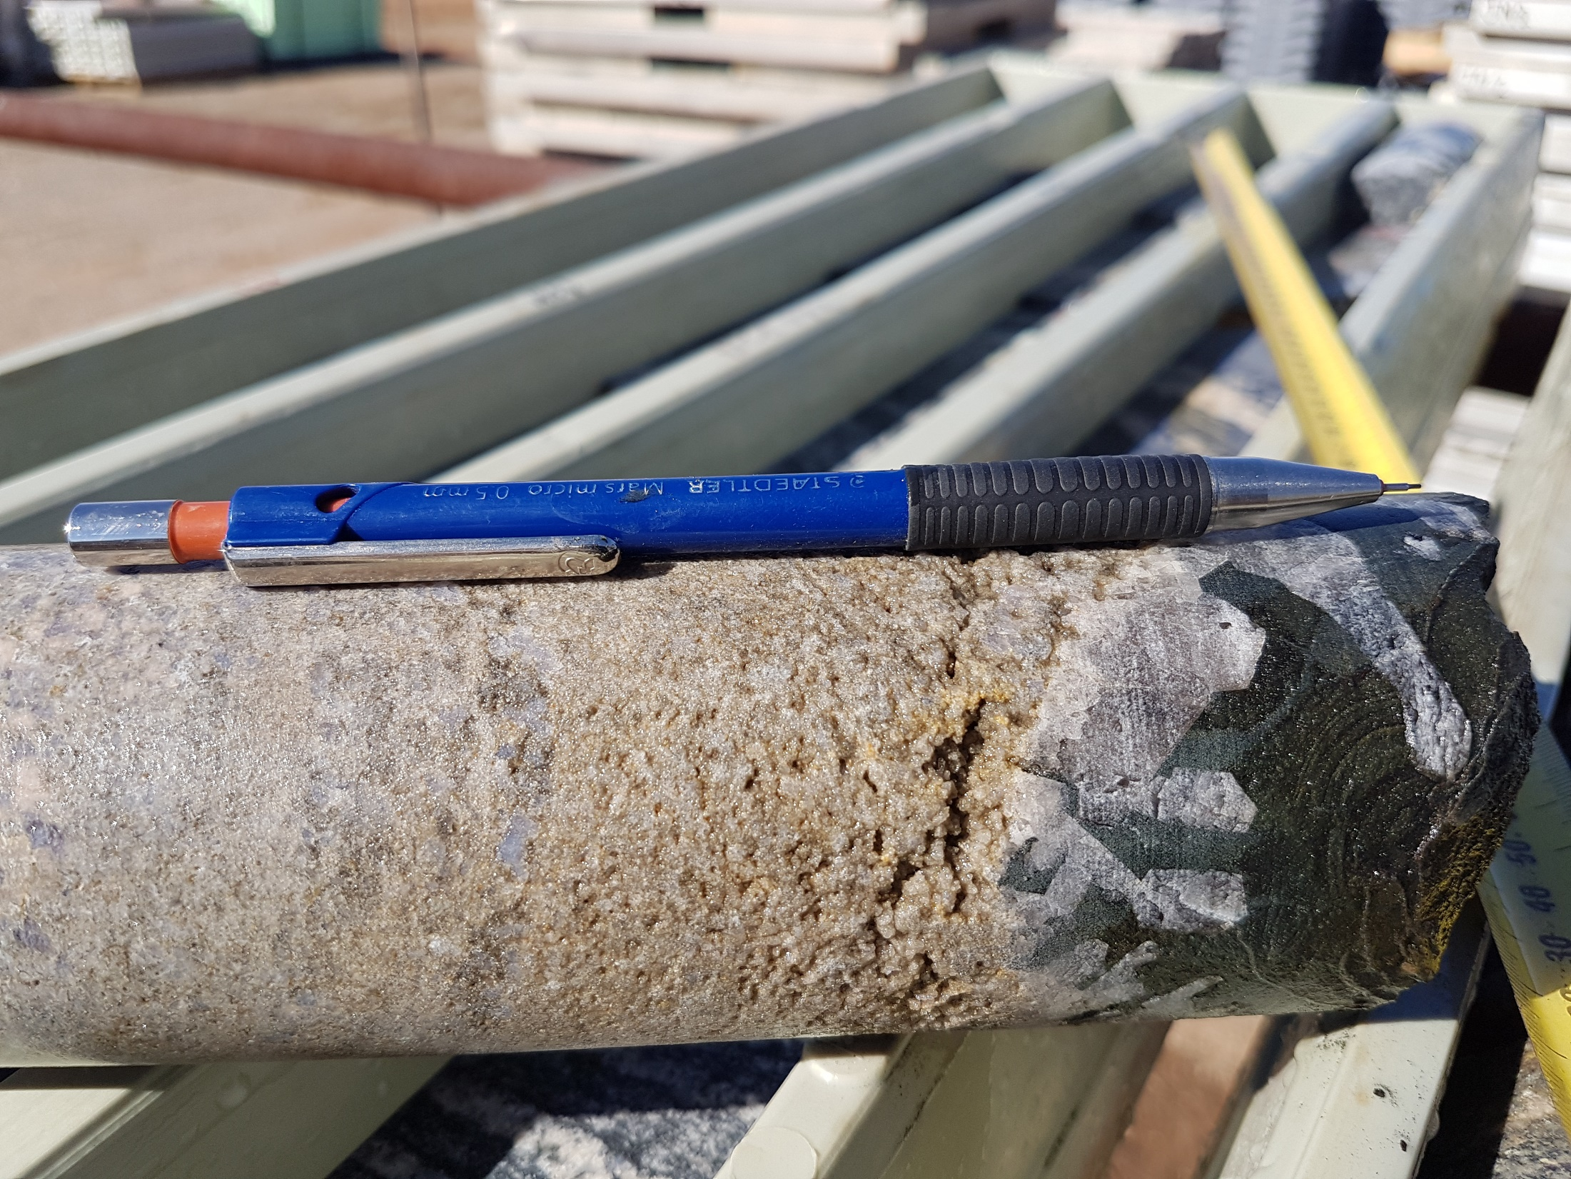

Slide 33
Alteration-Mineralisation
Early
Biotite-kspar-epidote-clinozoizite±titanite-allanite-apatite-scapolite
Magnetite-biotite-quartz-(pyrrhotite-pyrite with Co)±molybdenite±uraninite±chalcopyrite
Late
Quartz-chlorite-epidote-actinolite-carbonate-sericite±k-spar
Chalcopyrite-gold-pyrite±sphalerite±bornite

Slide 34
Geochemistry
Influx of Si-K-Fe-Mg-Mn
Anomalous in Cu-Au-Ag-Mo-Co-Ni-Sc-U-Re-Ce-La-V-S-In-P
Flavour: Mafic magmatic source and IOCG signature ?

Slide 35
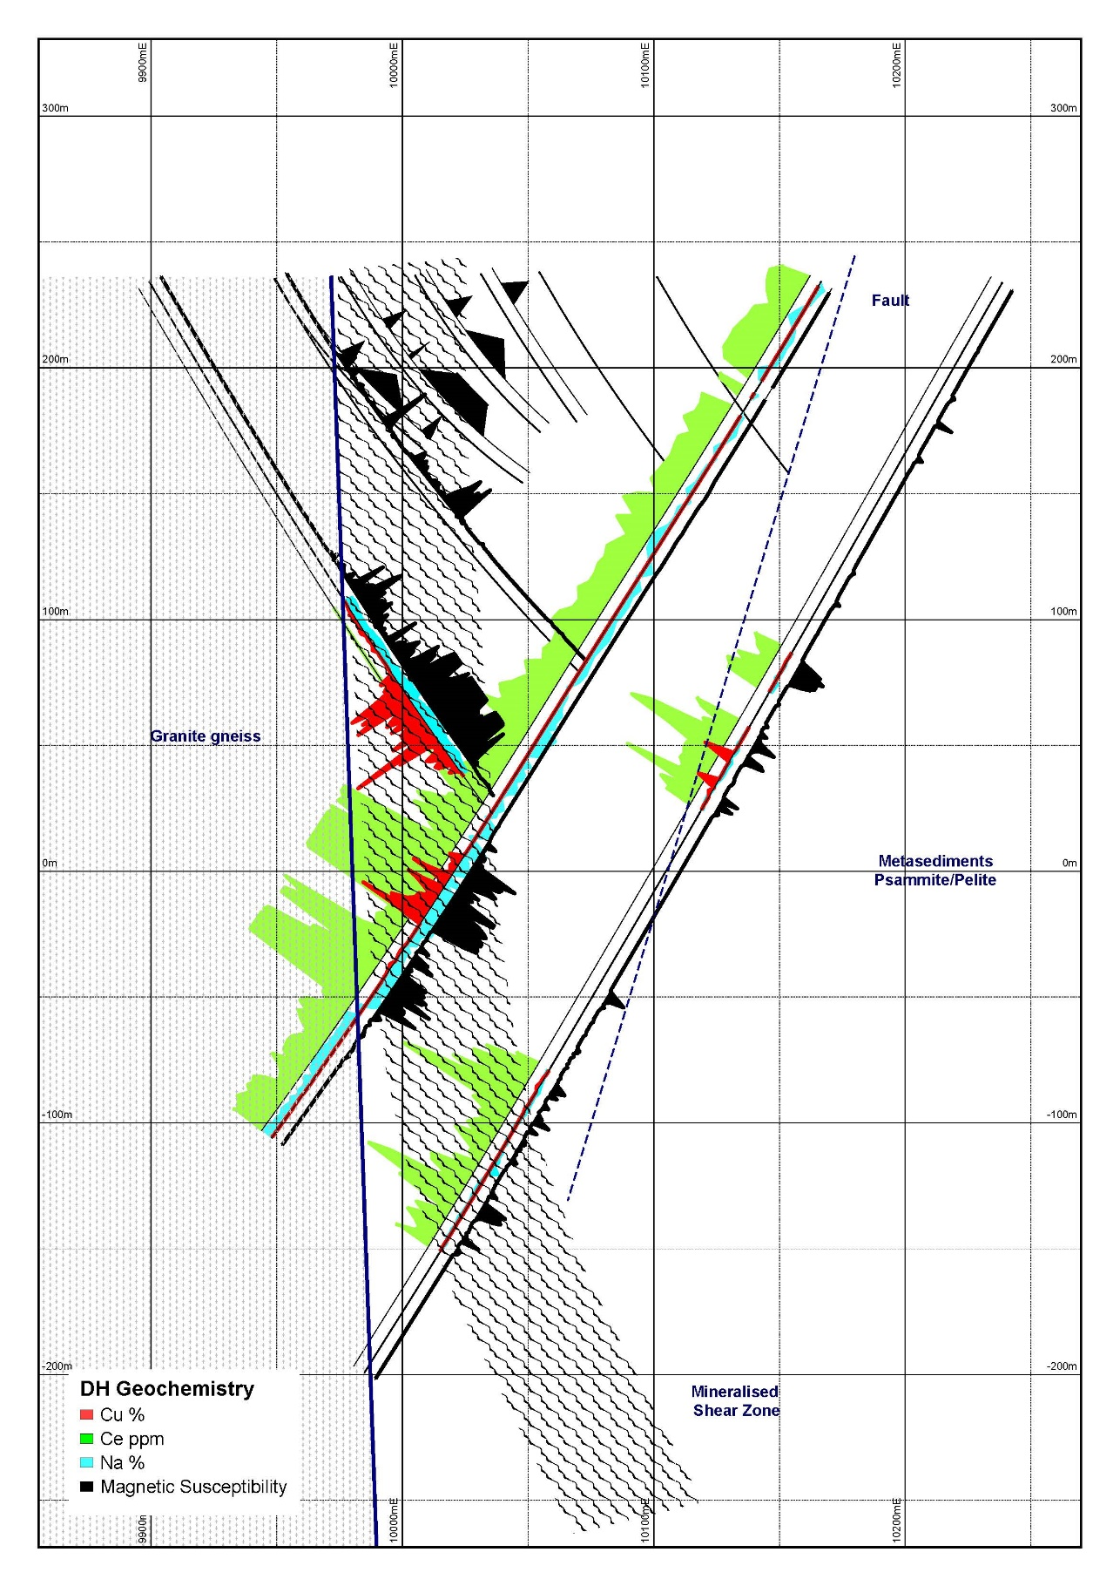
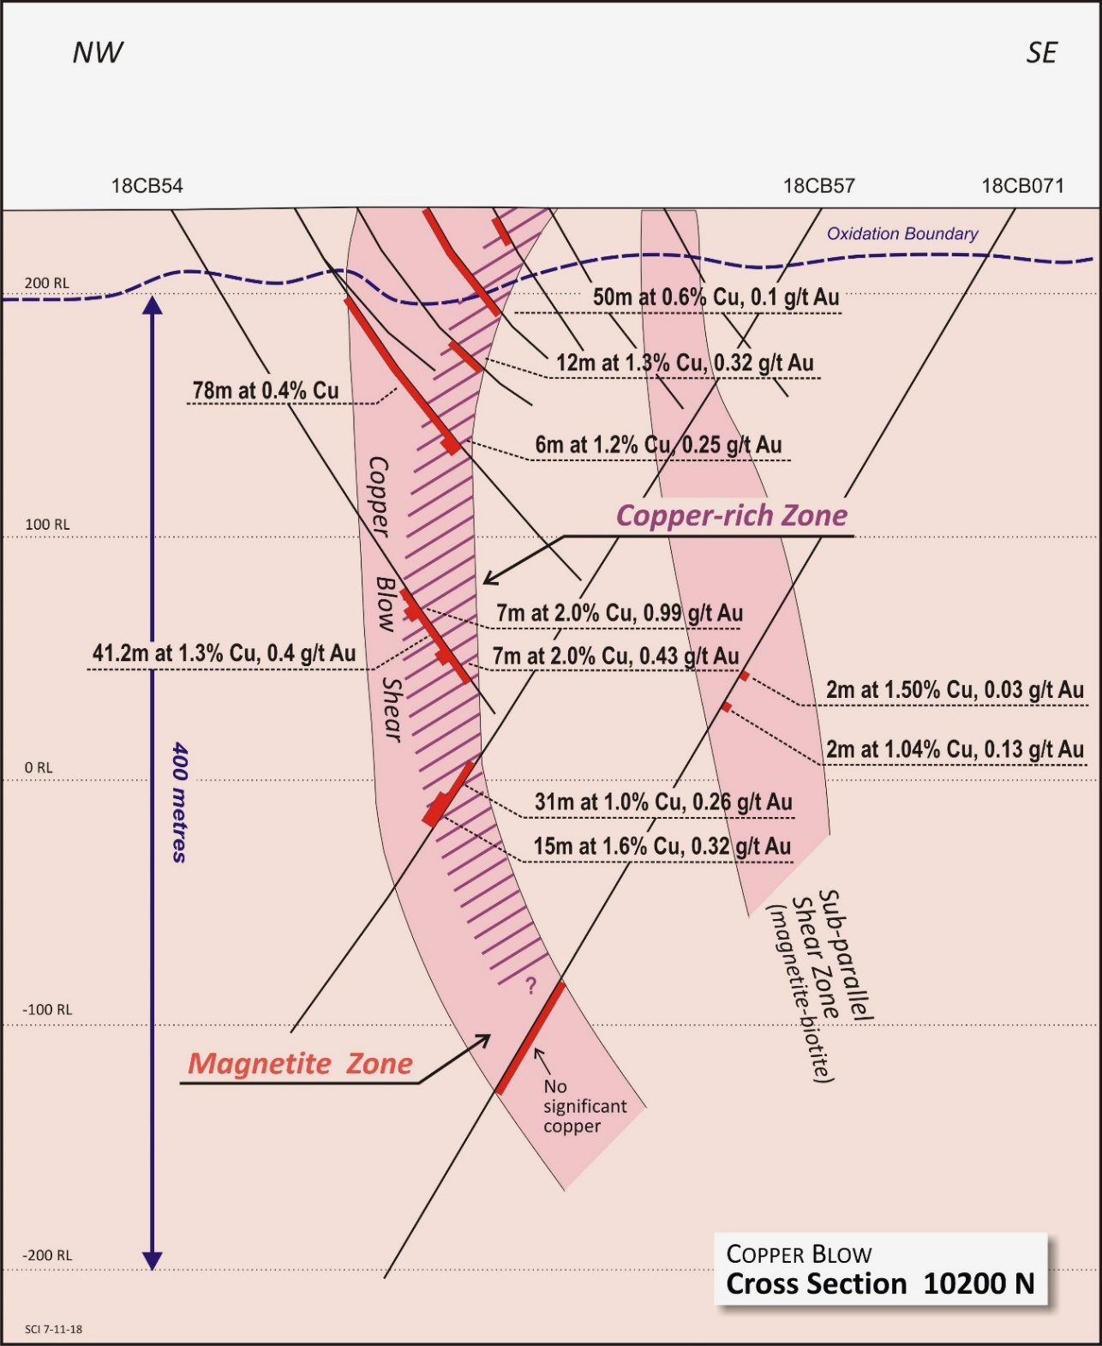

Slide 36
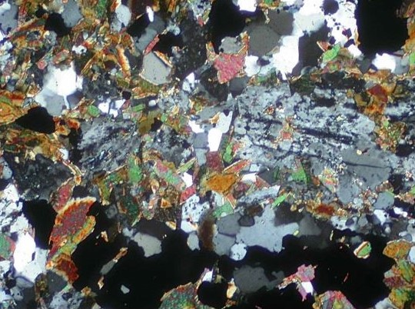
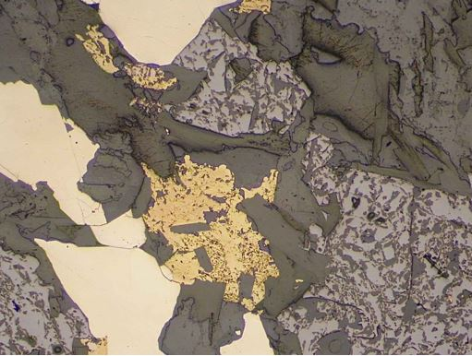
Mafic igneous rock, now composed of an assemblage of quartz, biotite, feldspars and magnetite (black). Partly altered remnant plagioclase is retained at centre-right. Transmitted light, crossed polarisers, field of view 2 mm across.
Magnetite (pale grey), with associated pyrite (pale creamy), chalcopyrite (yellow) and intergrown biotite (darker grey). Plane polarised reflected light, field of view 2 mm across.

Slide 37
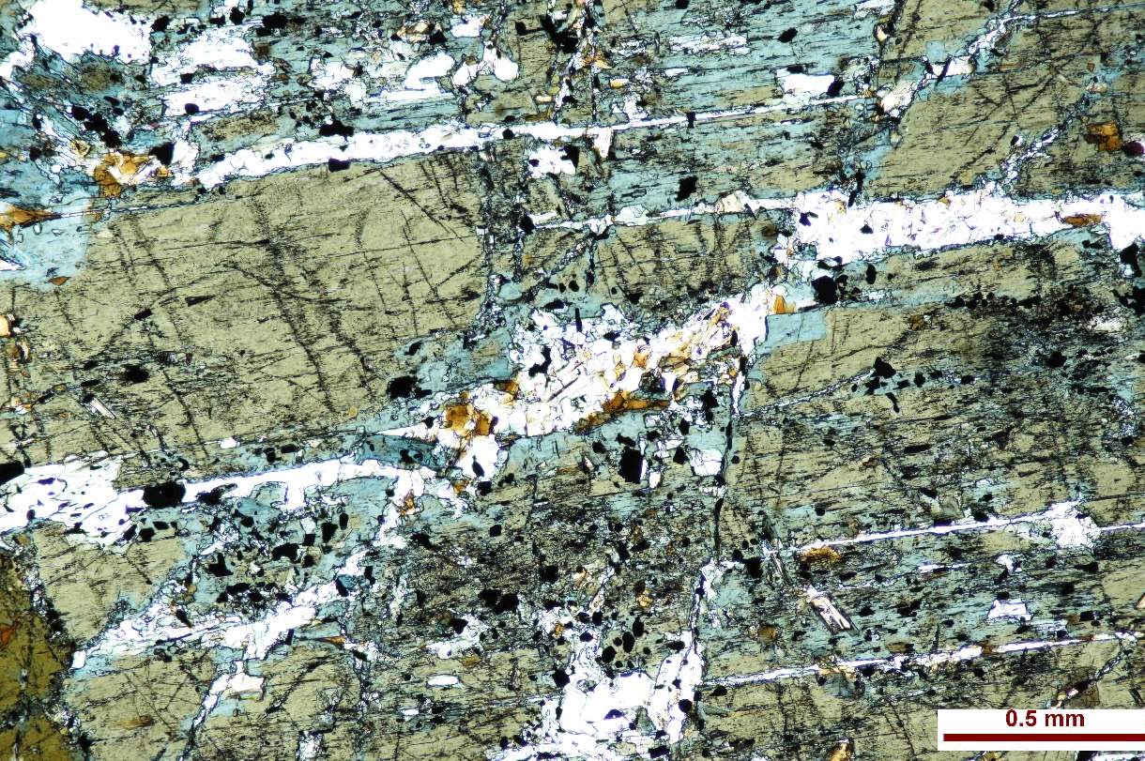
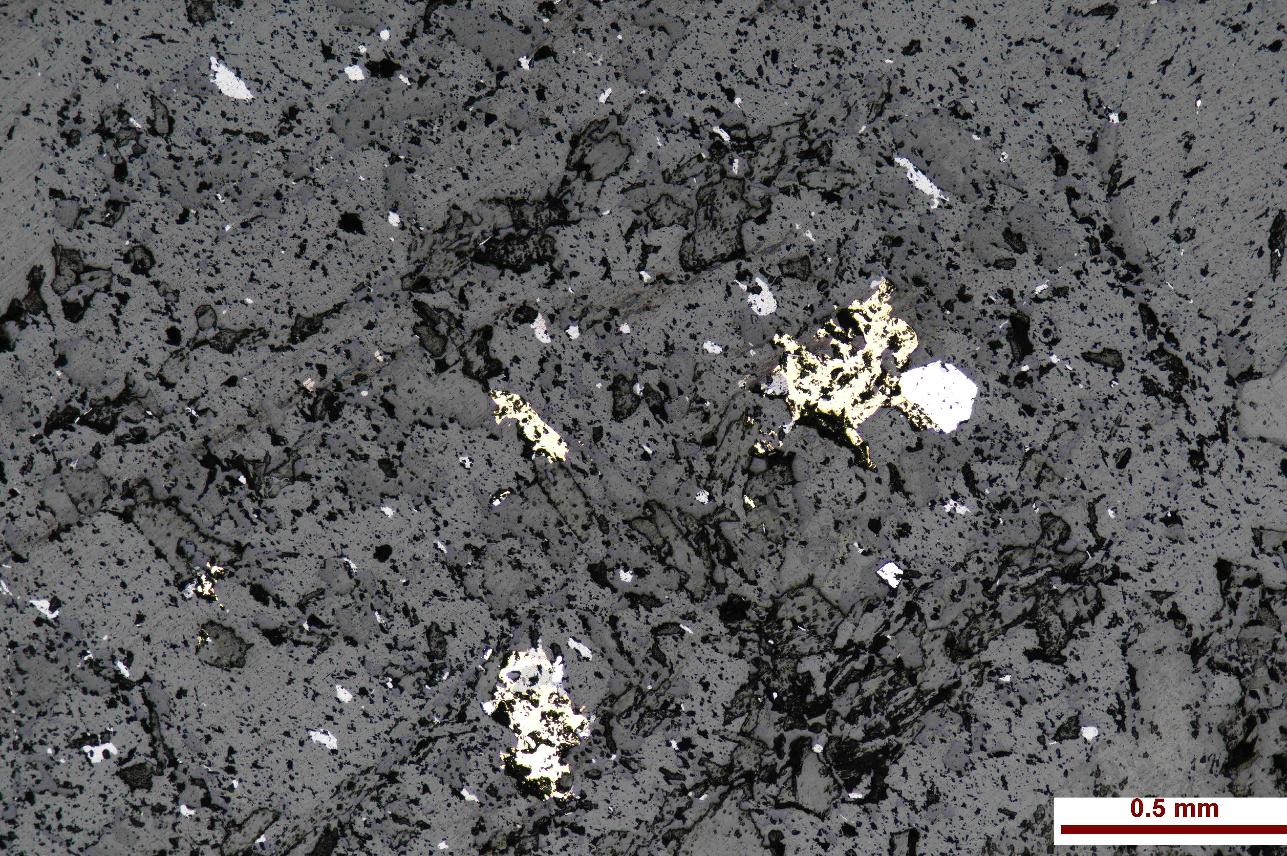
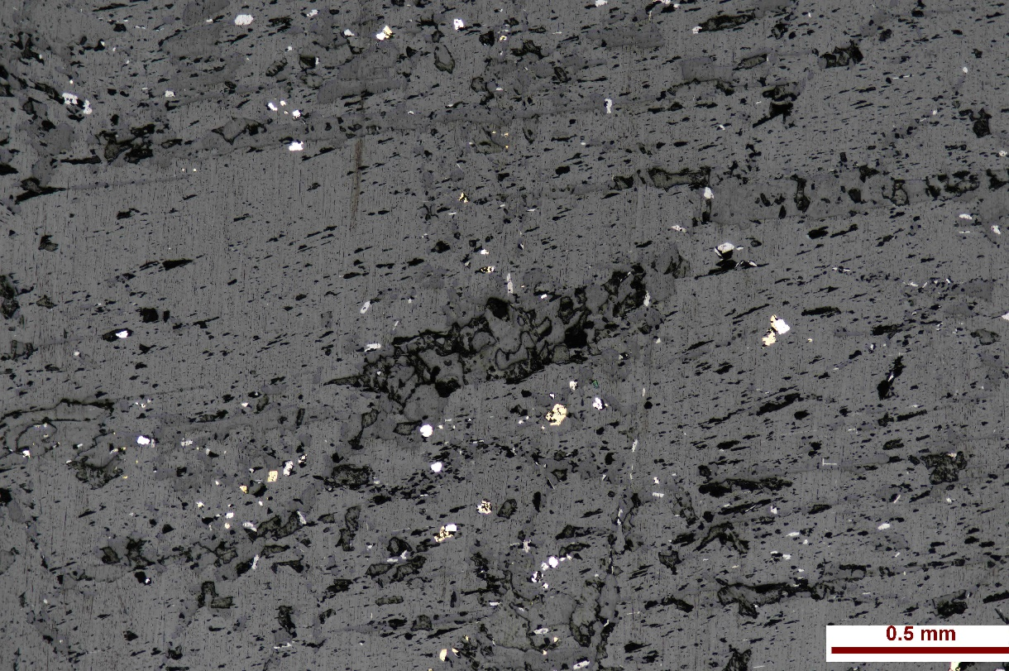
Hornblendite/Hornblende gabbro with strong actinolite alteration and exsolution of pyrite and chalcopyrite
Only clinopyroxene, no orthopyroxene: suggests has not undergone amphibolite/granulite grade metamorphism. Considered to be a later intrusion.
Courtesy of Joel Fitzherbert NSW Geological Survey

Slide 38
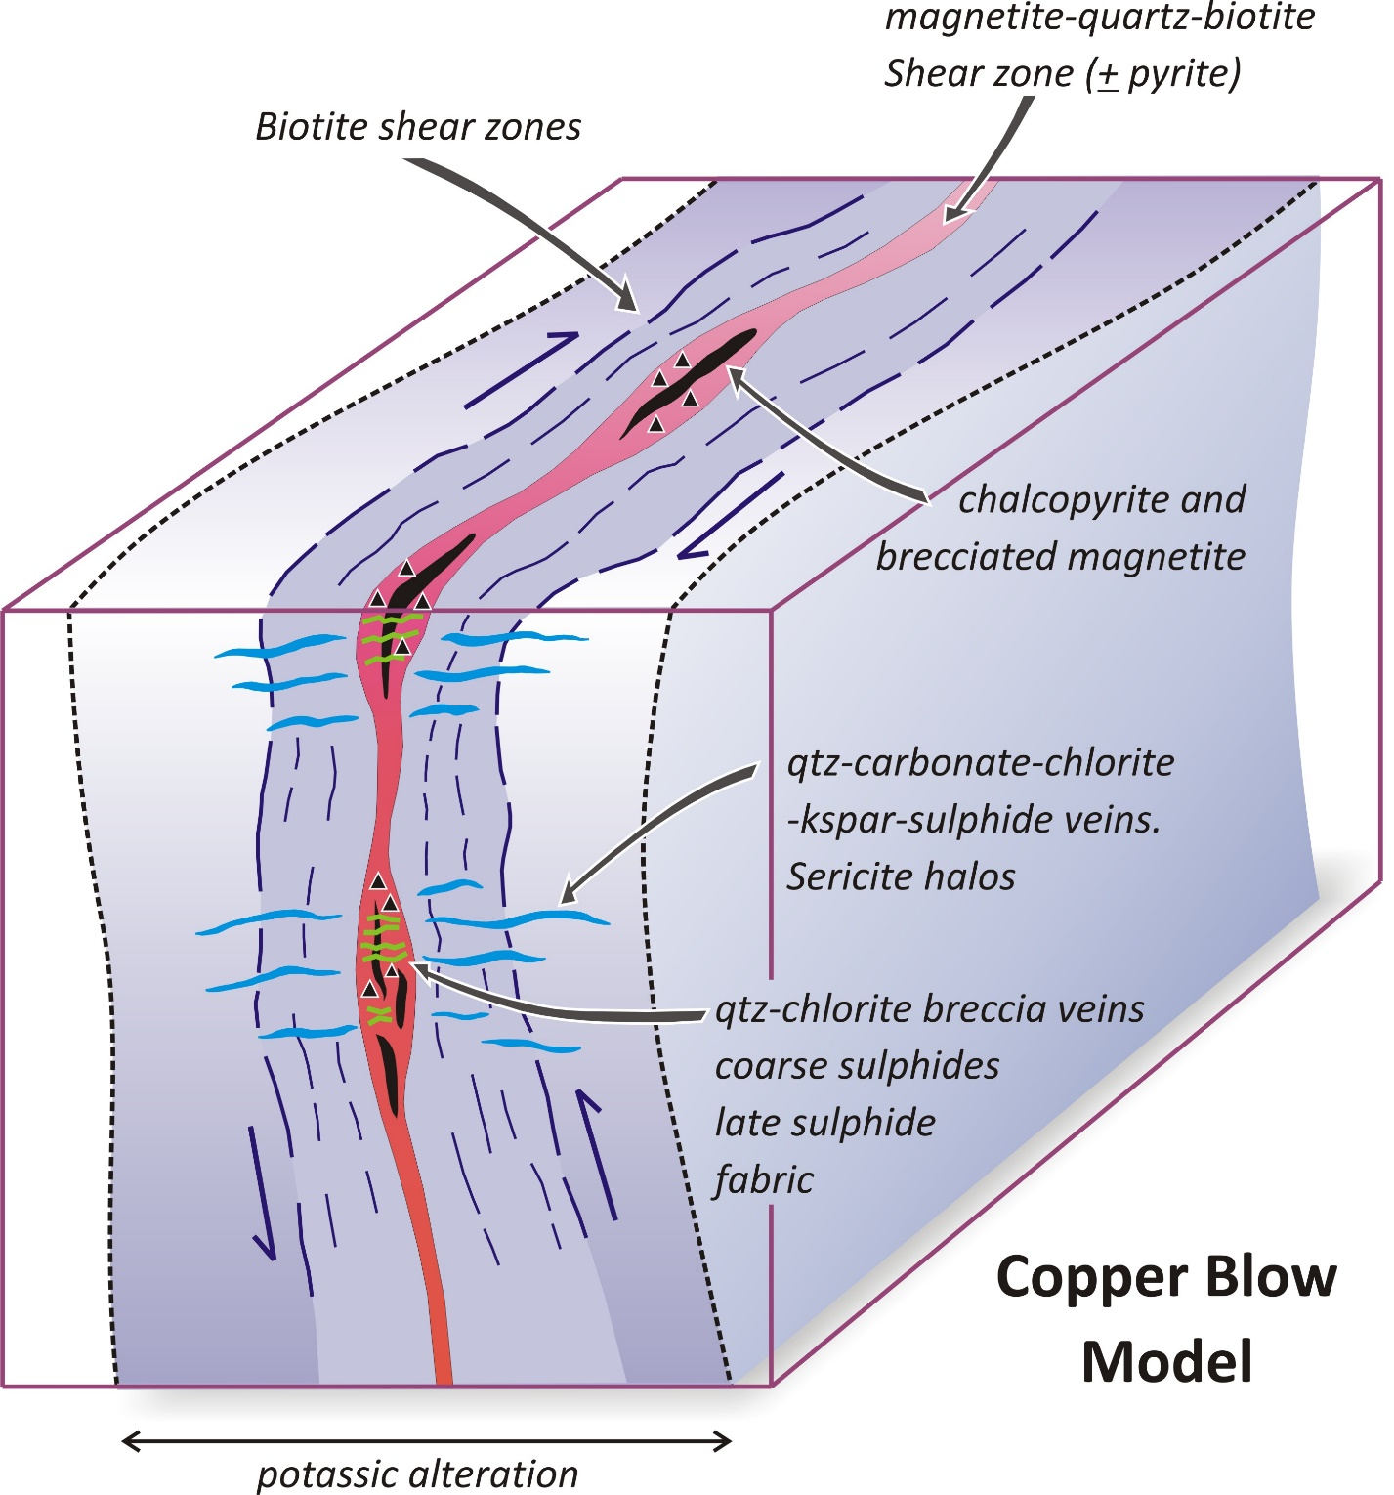
Dextral strike slip followed by reverse movements (SE over NW)suggests transient change in kinematics coincident with main phase or upgrading of copper mineralisation
Symmetrical alteration pattern focused on the shear zone

Slide 39
IOCG Geochem Soils:
Cu, Mo, Ce, La, Ni, Co
Gabbro
Specular hematite schists plus magnetite
IPT rock sample 6.5g/t Au and 11.8% Cu
Extensive magnetite
Magnetic Image

Slide 40
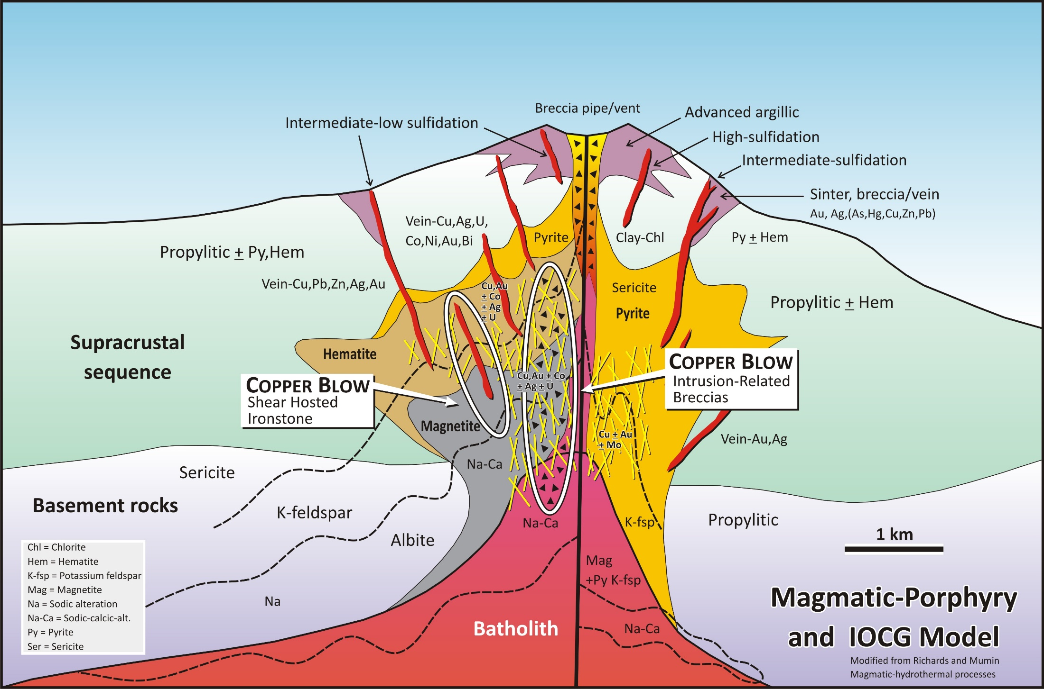

Slide 41
Age(?)
Little Broken Hill Gabbro
baddelyite 827 ± 9 Ma, zircon rims (metamorphic) 500 ± 7 Ma: Wingate et al Precambrian Research 87 (1998) 135-159 (²⁰⁷Pb/²⁰⁶Pb)
Alkalic Intrusions Impact Minerals ASX Release March 2019
Internal studies suggest mantle plume cerca 800 Ma
= Break up of Rodinia (Neoproterozoic Extension)
Copper Blow
magnetite 1094 ± 89 Ma, chalcopyrite 1071 ± 210 Ma : Bassano et al 2004 pmdCRC Conference. Pb-Pb step leaching.
Copper Blow:
allanite 1177 ± 21 Ma (NSWGS, Fitzherbert pers com)
= Grenvillian Orogeny (Formation of Rodinia)

Slide 42
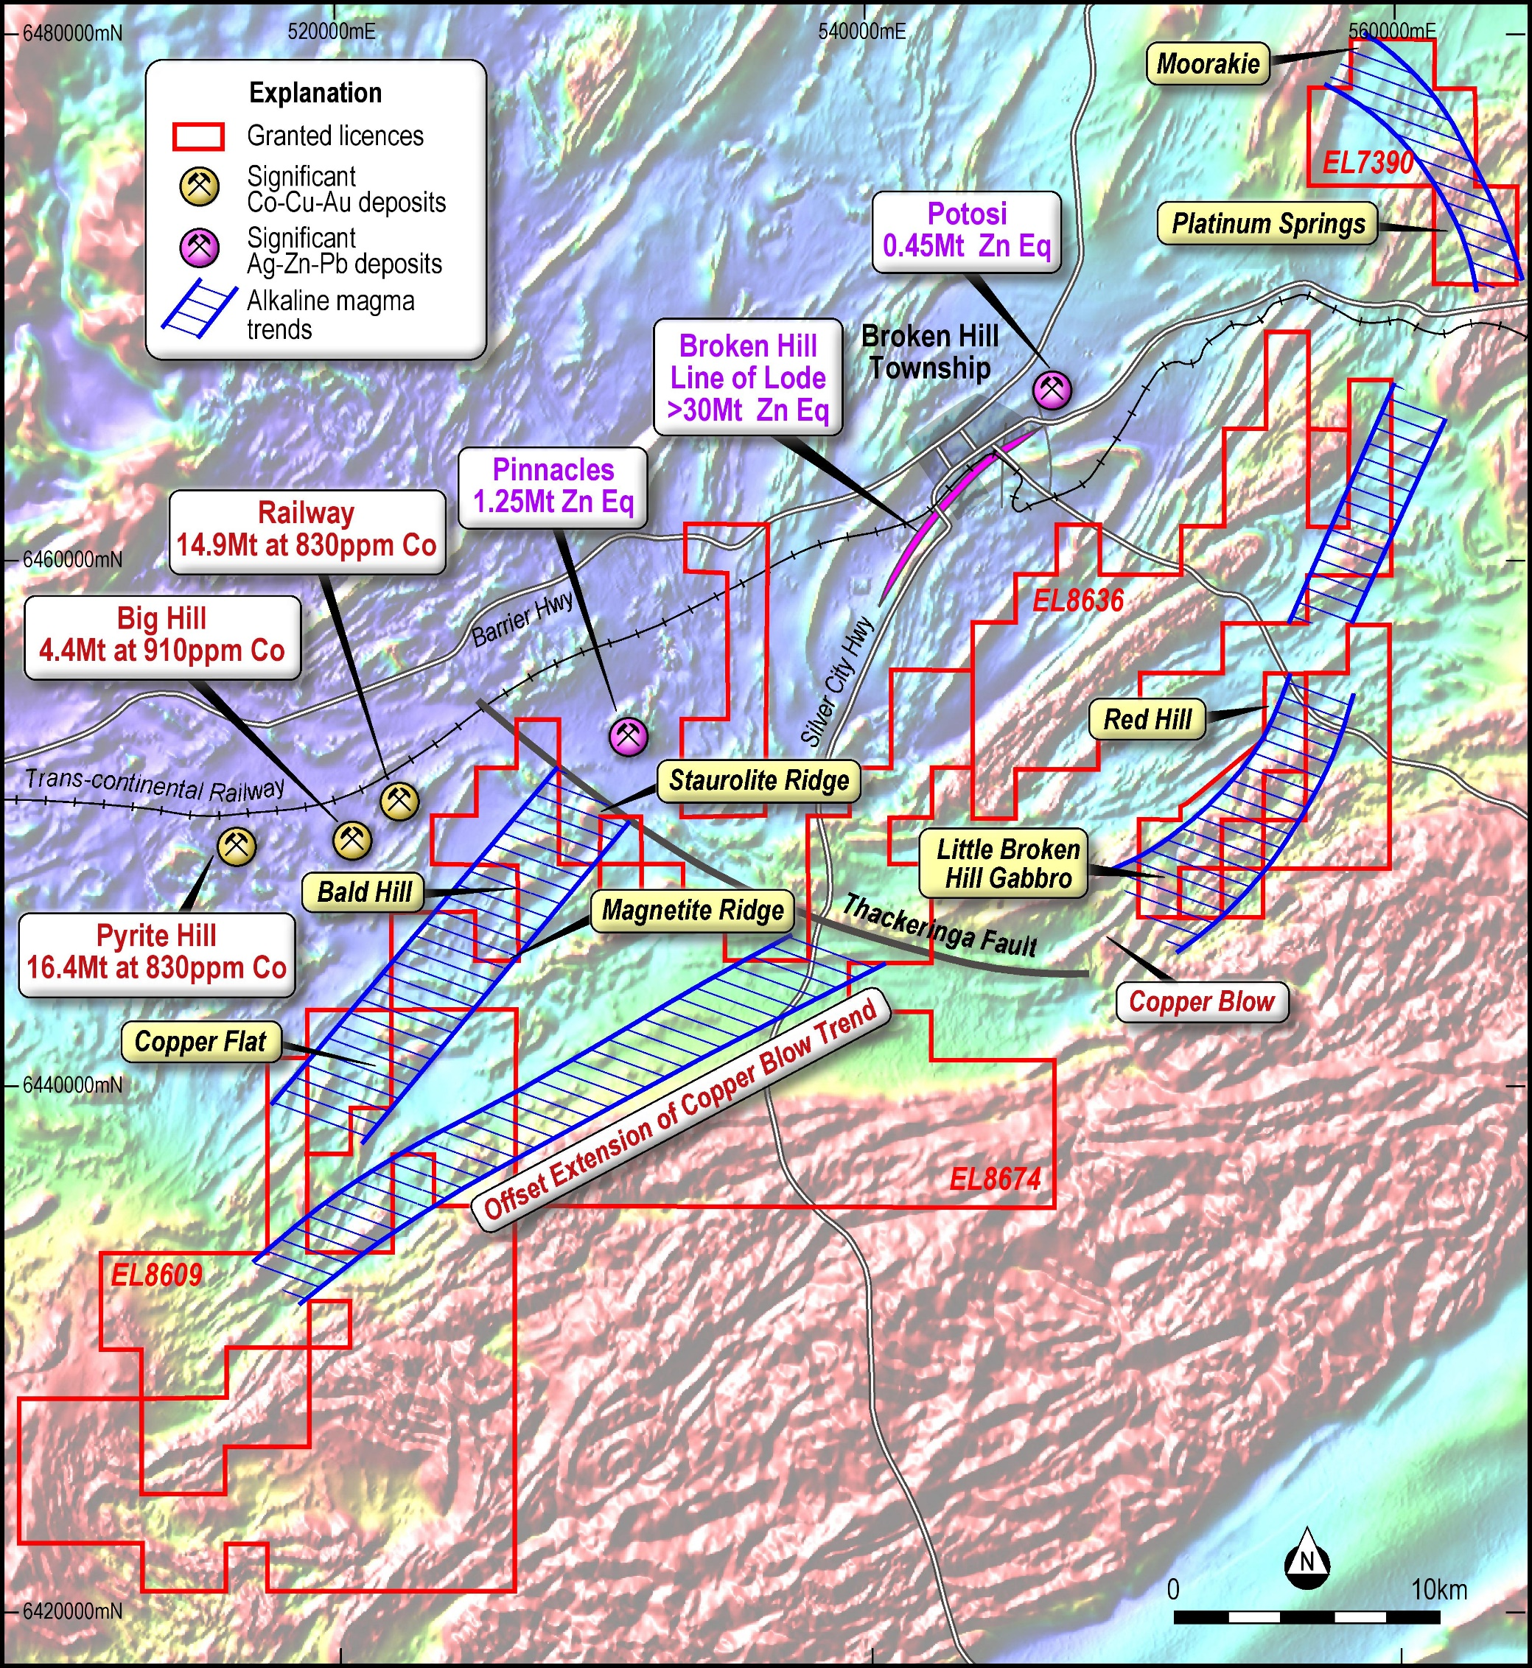
Pt-Pd
Silica Undersaturated Rocks: ijolites, urtites, nepheline syenites, carbonatites (Harzburgites, pyroxenites and gabbros) Cerca 800Ma
Pt-Pd-Cu-Ni
Pt-Pd
Pt-Pd-Ni
Cu-Au
IPT ASX Release : 6 March 2019

Slide 43
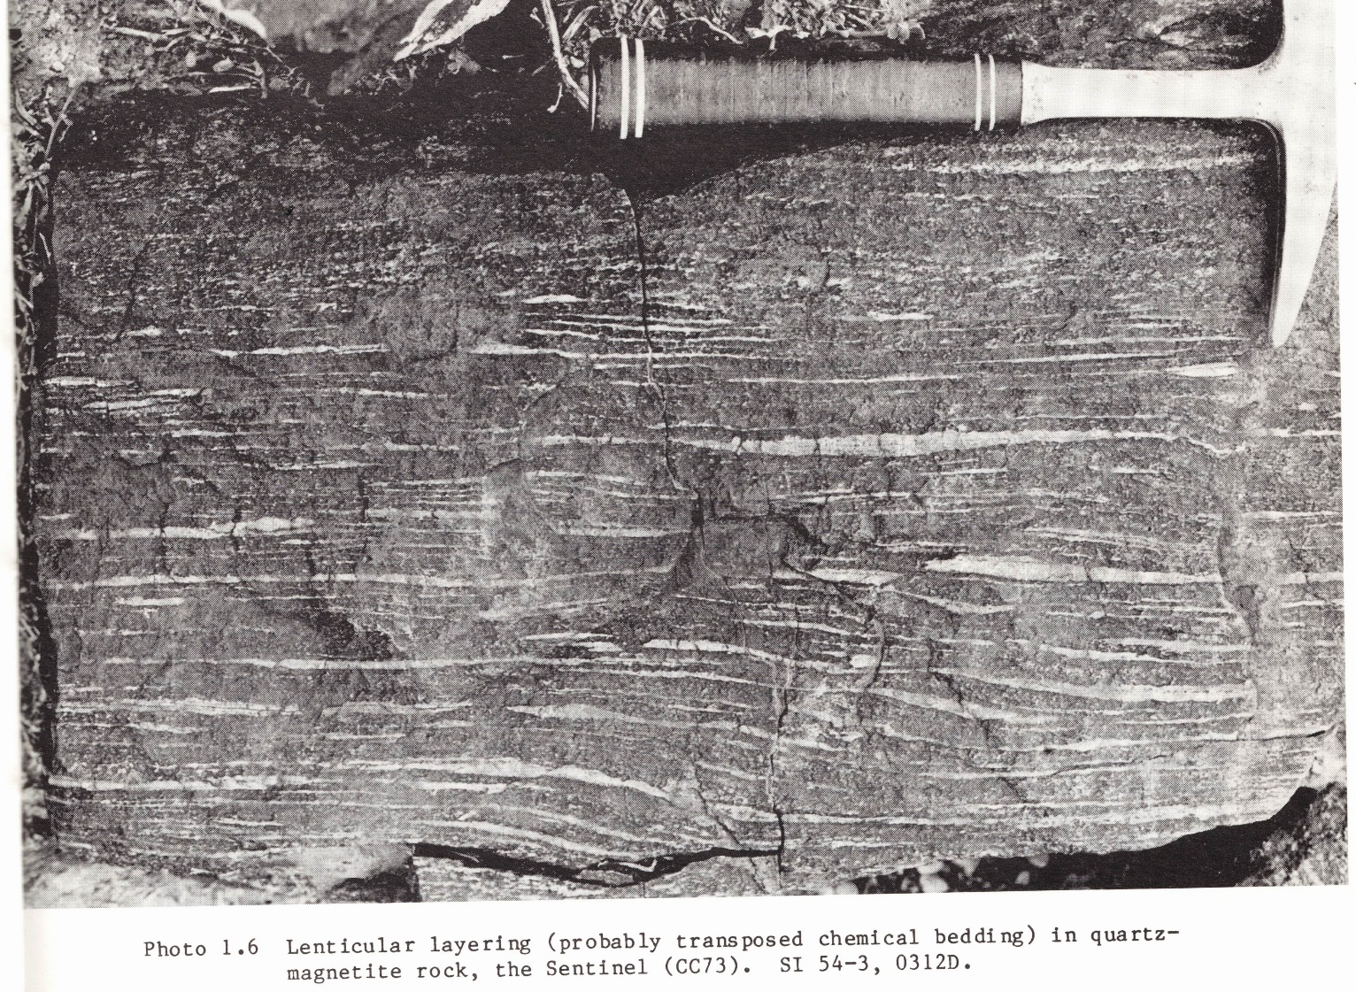
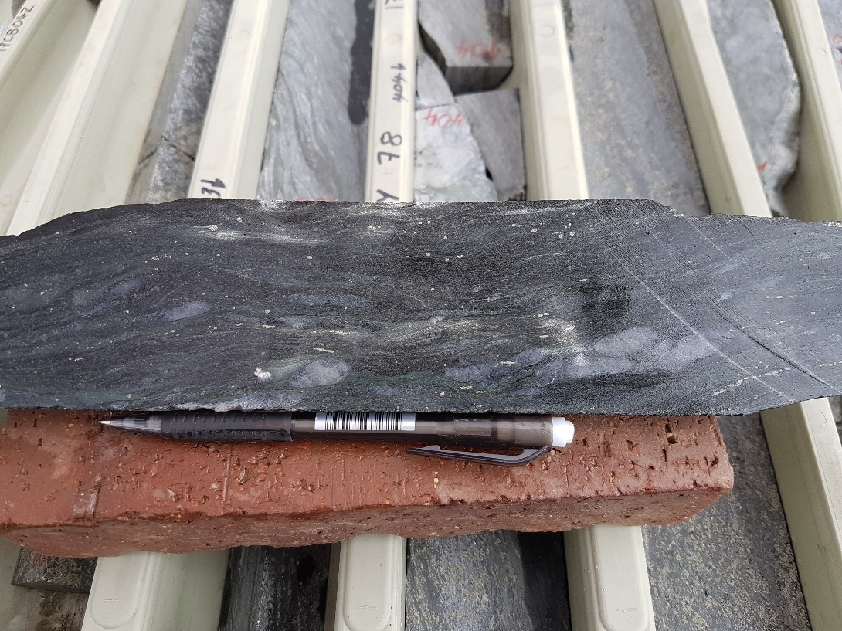
Others (?)

Slide 44
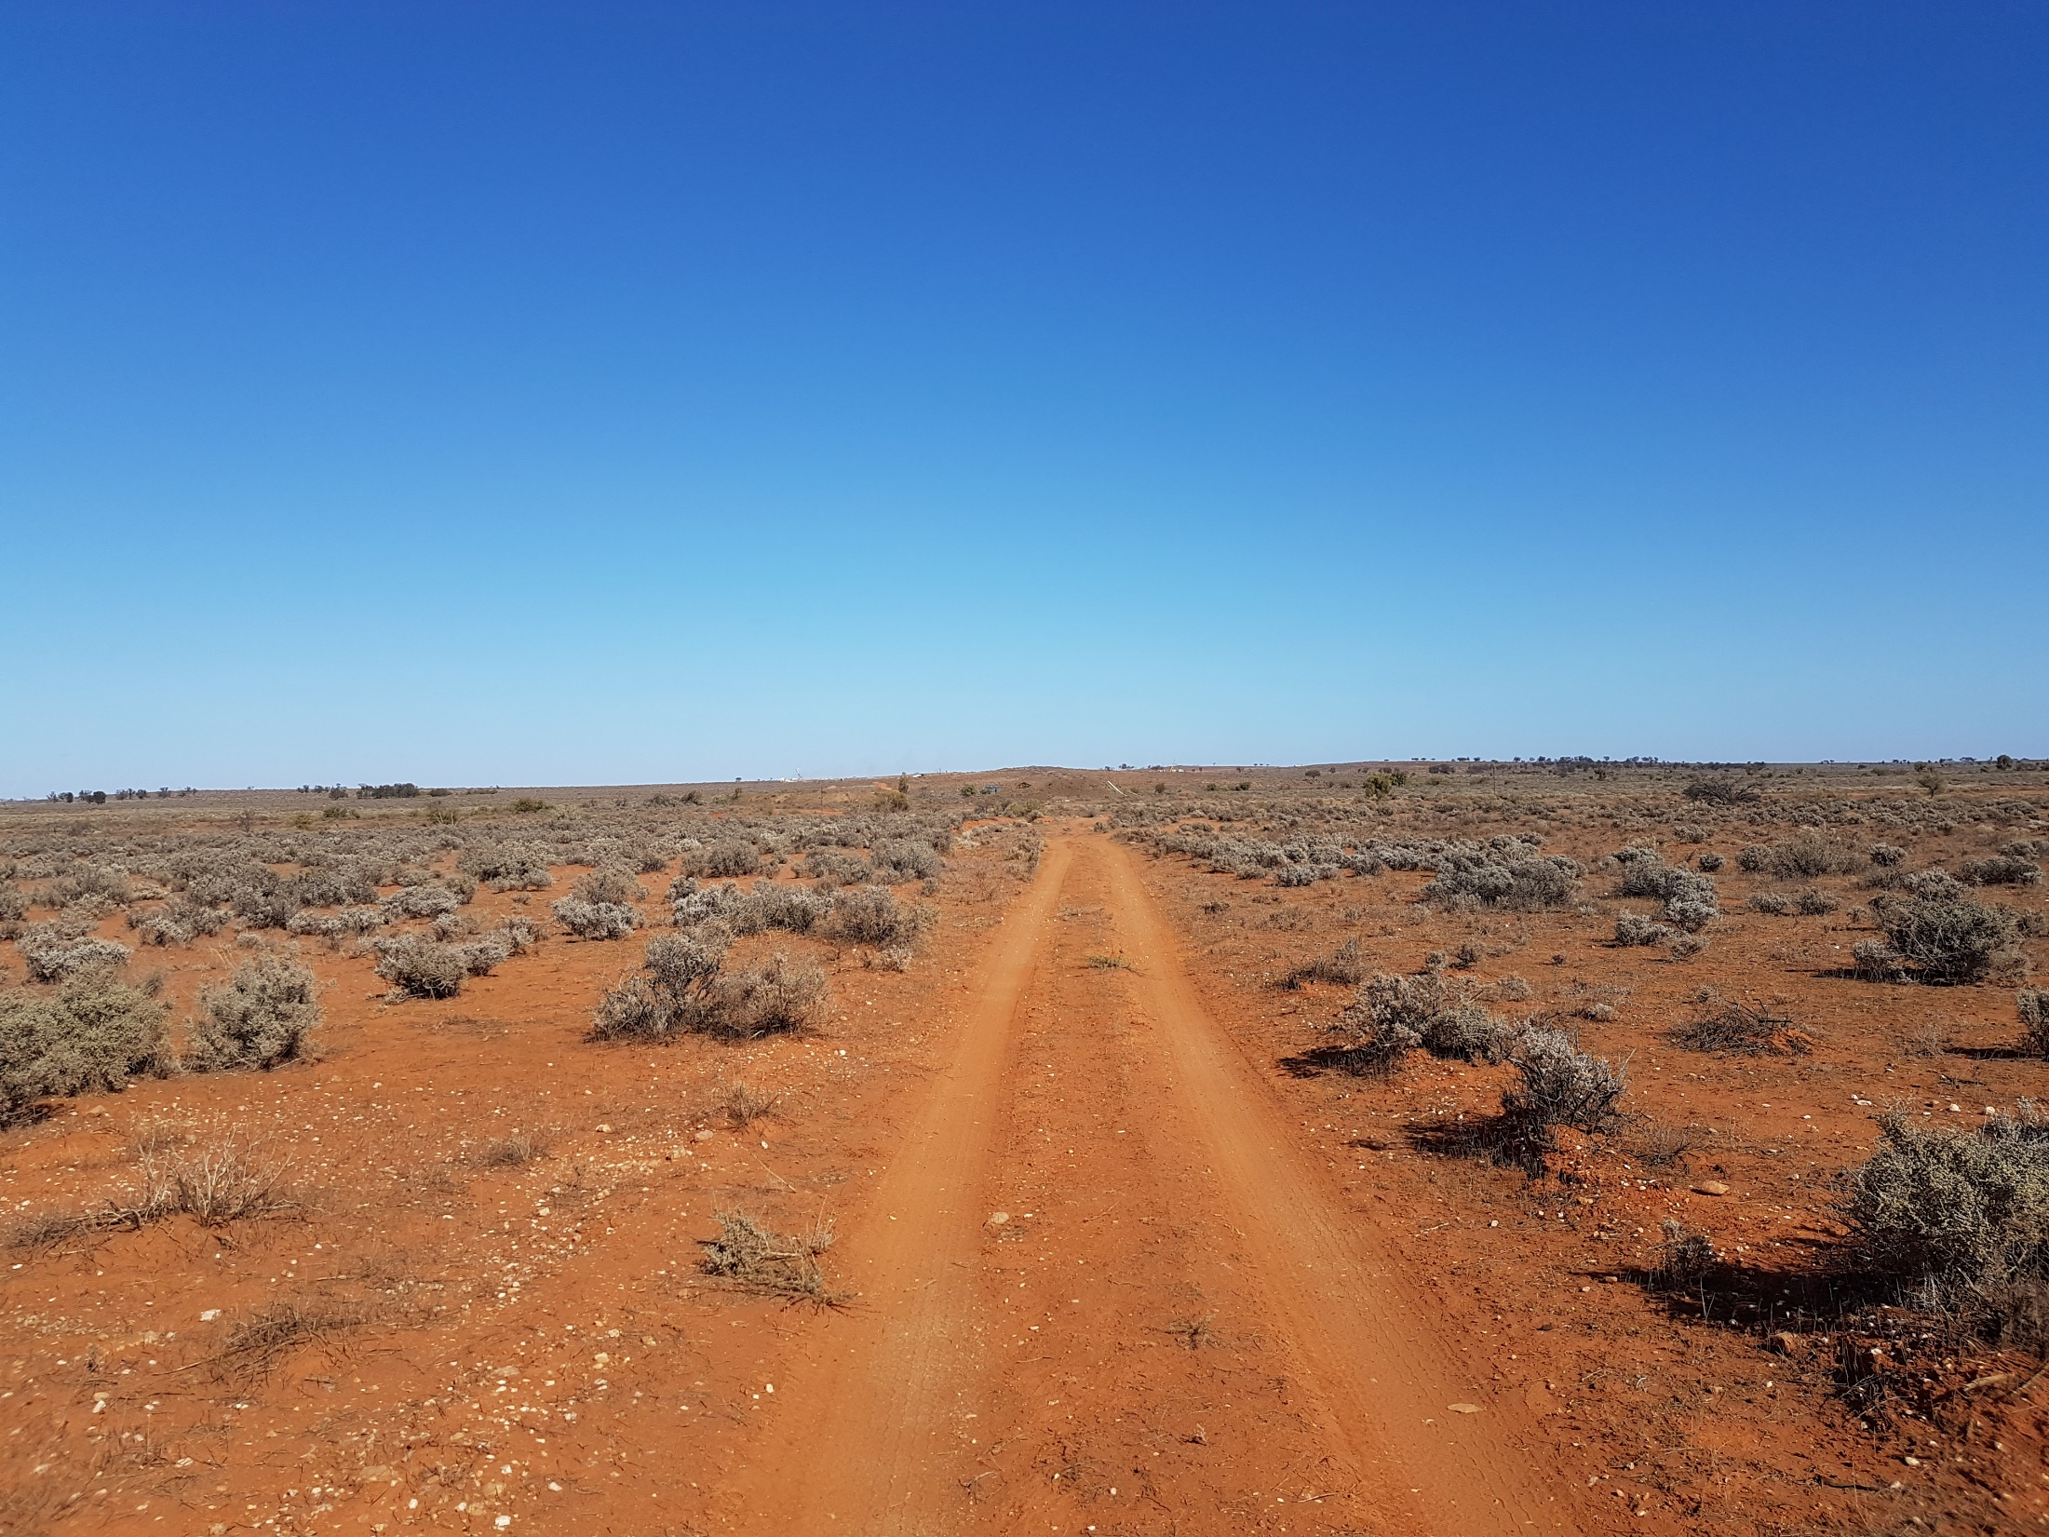


Slide 45
Conclusions
Copper-gold mineralisation introduced along a ductile shear zone
Early potassic alteration including magnetite (some early copper ± pyrite). Related to at least one phase of dextral strike slip movement.
Later sericite-chlorite alteration. Main copper-gold event. Related to transient change in kinematics to reverse thrust
Resultant ore morphology is poddy-tear drop shaped
Mineralisation is epigenetic possibly related to silica undersaturated intrusions
Significant potential for intrusion-related Cu-Au mineralisation related to magnetite and hematite close to the shear zone
Also potential for PGE, Ni-Cu sulphide and REE related to silica undersaturated rocks
Post peak Olarian (1600Ma), may be Grenvillian (1177Ma) or as young as 800Ma

Slide 46
References
SCI ASX Releases: 16 Nov 2017, 4 Jan 2018, 5 Feb 2018, 28 May 2018, 5 July 2018, 30 Oct 2018, 9 Nov 2018
IPT ASX Releases: 6 March 2019

